Slide 1


Explainability for Natural Language Processing
Tutorial@AACL-IJCNLP 2020
² Shipi Dhanorkar
¹ Lucian Popa
¹ Yunyao Li
¹ Kun Qian
¹ Christine T. Wolf
¹ Anbang Xu
¹ IBM Research – Almaden
² Pennnsylvania State University
Notes:
Welcome to our tutorial on Explainability for Natural Language Process at AACL 2020.
The names of the presenters are shown in this slide, we are a group of researchers working on different aspects of AI research including social science, natural language processing, and human computer interaction.

Slide 2
Outline of this Tutorial
PART I - Introduction
PART II - Current State of XAI Research for NLP
PART III – Explainability and Case Study
PART IV - Open Challenges & Concluding Remarks
Notes:
In the next 3 hours, we are going to talk about the explainability for natural language processing from different aspects.
Specificially, this tutorial contains four parts:
Part I – introduction
Part 2 – current state of XAI research for NLP
Part 3 – Explainability and case study
Part 4 – Open challenges and concluding remarks

Slide 3


PART I - Introduction
Yunyao Li
Notes:
Before we work on solving any problem, the most important question to answer is WHY we need to work on it. In this part, I will present a high-level overview of why explainability is an important research problem to work and what are the associated challenges.

Slide 4
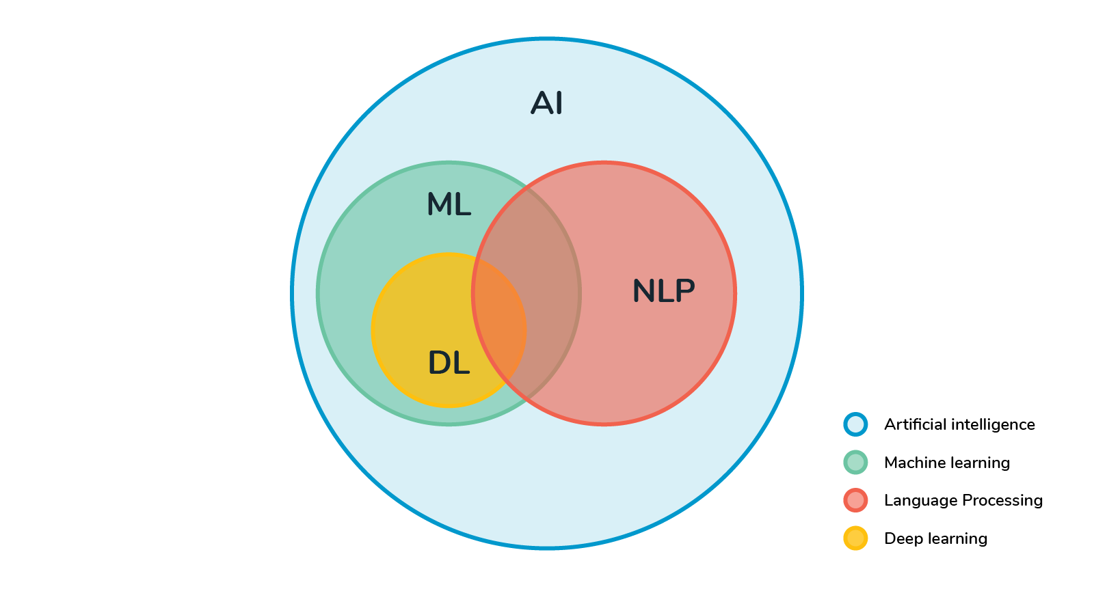
AI vs. NLP
source: https://becominghuman.ai/alternative-nlp-method-9f94165802ed
Notes:
Since NLP is an important area of AI and the need for explainability is universal for all AI areas.
In this part, I will motivate the need for explainability for AI in general, with a combination of examples from NLP as well as other areas of AI. Towards the end, I will discuss specific challenges for explainability for NLP before my colleagues presenting an overview of recent explainability techniques for NLP.

Slide 5





AI is Becoming Increasing Widely Adopted
… …
Notes:
I hope that I don’t have to convince anyone that AI is becoming increasing important and widely adopted. As you can see from the few news headlines, AI is ready for its prime time and is transforming almost every single industry from retail to banking to government. It is changing the life of everyone in the world.

Slide 6
AI Life Cycle
Business Understanding
Data Acquisition & Preparation
Model Development
Model Validation
Deployment
Monitor & Optimize
Notes:
Here is a high-level overview of the simplified life cycle of an AI model.
As can be seen, the life cycle of an AI model consists of six iterative stages: 1. Business understanding: where in order to decide what model to build, one needs to understand what is the high-level business problem to solve and what is the technical solution to help solve that problem. For instance, an important high-level business problem for NetFlex is how to provide more relevant content to its customers, and one technical solution to find a better recommendation model for movies and TVs. 2. Data acquisition and preparation: once one understands the technical solution and what kind of models to built, the next step is to acquire the appropriate data and prepare the data accordingly to help the development of the model. 3. Model development: this is the stage where one actual builds the models.
4. Model validation: this is the stage where one validates and confirms that models are built as intended. 5. Deployment: this is the stage where the validated model is put to production and used to solve the actual business problem in a business process.
6. Monitor and Optimize: Post deployment, we still need to monitor the usage of the model and ensure that it is functioning and used as intended. Additional improvements may be made to further optimize its quality and performance.
I will now discuss in more details the needs for explainability in each of the stages.

Slide 7
An Engineering Perspective
Why Explainablity?
Notes:
In the research community, when we talk about explainability, most of the time our work focus on the need for explainabilty from an engineering perspective.

Slide 8
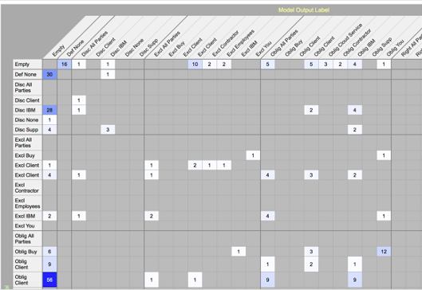

Why Explainability: Model Development
Business Understanding
Data Acquisition & Preparation
Model Development
Model Validation
Deployment
Monitor & Optimize
Error Analysis
e.g. “$100 is due at signing”
is not classified as <Obligation>
Feature Engineering
(e.g. POS, LM)
Model Training
Model Evaluation
Model Selection/Refinement
Error Analysis
Root Cause Identification
e.g. <Currency> is not
considrerd in the model
Model Improvement
e.g. Include <Currency> as a feature / or introduce entity-aware attention
AI engineers/
data scientists
Source: ModelLens: An Interactive System to Support the Model Improvement Practices of Data Science Teams. CSCW’2019
Notes:
The engineering perspective mainly involves two stages: The first one is Model development. During this stage, the model developers, who are often AI engineers and or data scientists, often needs to go through the iterative process of feature engineering (including deciding which pretrained language models to use), model selection and refinement, the actual model training, evaluation and error analysis. Explainabilty of a model is important to help the model developers to identify the possible root cause of the errors and improve the model.
In our example, during the error analysis, when the model developer find that “$100 is due at signing” is not classified as a <Obligation>, by inspecting explaination of the model, they can find that root cause of this error is that entities such as <Currency> is not considered, and possible ways to improve the model could be add entity type <Currency> as a feature to the model or introduce entity-aware attention to the model.

Slide 9

Why Explainability: Monitor & Optimize
Business Understanding
Data Acquisition & Preparation
Model Development
Model Validation
Deployment
Monitor & Optimize
User Feedback
e.g. Clauses related to trademark
should not classified as <IP>
User Feedback (implicit/explicit)
Model Improvement
Feedback Analysis
Feedback Analysis
e.g. Trademark-related clauses are
considered part of <IP> category by
The out-of-box model
Model Improvement
e.g. Create a customized model to
distinguish trademark-related clauses from other IP-related clauses.
AI engineers
Source: Role of AI in Enterprise Applications.
https://wp.sigmod.org/?p=2577
Notes:
Another important stage where explainability is required from the engineering perspective is the stage of “monitor & optimize”.
Similar to what we have seen in “Model Development”, when by analyzing user feedback, which could be provided explicitly or implicitly, AI engineers identify that “clauses related to trademark in contracts are incorrectly classed as <IP>. Based on this feedback and explainability provided by the model, one can identify that this error is caused by the out-of-box model which considers trademark-related clauses are considered part of <IP> category. One possible way to improve the model is to Create a customized model to distinguish trademark-related clauses from other IP-related clauses.

Slide 10
A Practical Perspective
Why Explainablity?
Notes:
Clearly, from engineering perspective, explainability is important. Now, I will explain why it is even more important from the practical perspective.

Slide 11
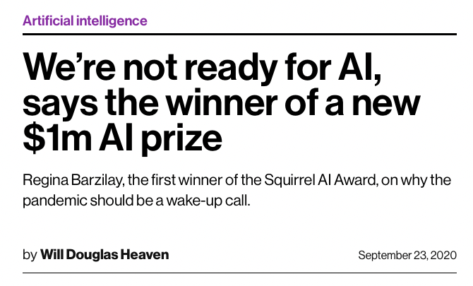

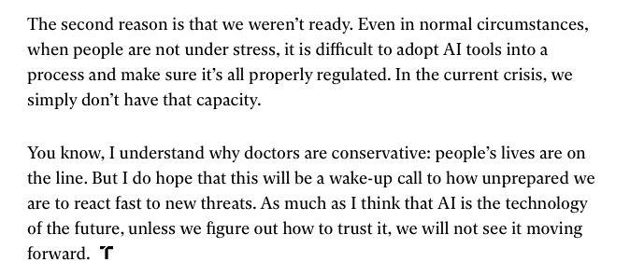
https://www.technologyreview.com/2020/09/23/1008757/interview-winner-million-dollar-ai-prize-cancer-healthcare-regulation
Notes:
Before I go into the details, let’s first take a quick glance of this interview with Regina Barzilay, a well-known NLP researcher and first winner of the Squirrel AI award, on why we are not ready for AI.
I will not go through the entire article but just share a couple of key points.
Regina calls out that “it is difficult to adopt AI tools into a process and make sure it’s all properly regulated”.
As a result, “as much as II think that AI is the technology of the future, unless we figure out how to trust it, we will not see it moving forward”.

Slide 12



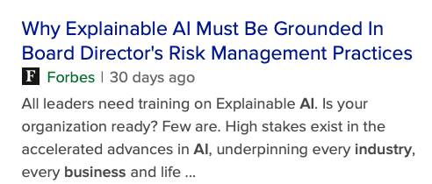


Needs for Trust in AI → Needs for Explainability
What does it take? - Being able to say with certainty how AI reaches decisions - Building mindful of how it is brought into the workplace.
Notes:
As Regina has called out the critical nature to establish trust in AI. Many others has also done so.
The needs for trust AI leads to the needs for explainability. For one to trust AI, there are two basic requirements: 1. Users of the AI should be able to say with certainty how AI reaches decisions
2. AI needs to be brought into the workplace in a careful manner and taking existing business process, practices, regulations into consideration. Now, I will revisit the AI life cycle discussed a few minutes earlier and explain in more details why explainability is important from a practical perspective throughout the AI life cycle.

Slide 13
Why Explainability: Business Understanding
Business Understanding
Data Acquisition & Preparation
Model Development
Model Validation
Deployment
Monitor & Optimize
When Explainablity Not Needed
No significant consequences for unacceptable results → E.g., ads, search, movie recommendations
Sufficiently well-studied and validated in real applications
→ we trust the system’s decision, even if it is not perfect
E.g. postal code sorting, airborne collision avoidance systems
Source: Men Also Like Shopping: Reducing Gender Bias Amplification using Corpus-level Constraints. Jieyu Zhao, Tianlu Wang, Mark Yatskar, Vicente Ordonez, Kai-Wei Chang. EMNLP’2017
Notes:
When building a model, the first critical question to answer is to understand whether explainability is needed and if so, what level is required during different stages in the AI life cycle.
For instance, there are cases where explainablity are not needed at all.
Such cases in general fall into two categories.
The first category of cases are those where there is no significant consequence for unacceptable results. Such cases are fairly common in our daily lives. Think about movie recommendation, advertisement and search. You don’t really expect the underlying AI models to provide detailed explanation of their results, since the impact of unacceptable results may not be desired from business point of view, the consequence in general is relatively minor to individual users.
The second category of cases are those that have been sufficiently well-studies and validated in real applications. Thinking about postal code sorting systems and airborne collision avoidance systems. For such systems, we in general trust the system’s decision, even if it is not perfect.

Slide 14
Regulations
General Data Protection Regulation (GDPR): Article 22 empowers individuals with the right to demand an explanation of how an automated system made a decision that affects them.
Algorithmic Accountability Act 2019: Requires companies to provide an assessment of the risks posed by the automated decision system to the privacy or security and the risks that contribute to inaccurate, unfair, biased, or discriminatory decisions impacting consumers
California Consumer Privacy Act: Requires companies to rethink their approach to capturing, storing, and sharing personal data to align with the new requirements by January 1, 2020.
Washington Bill 1655: Establishes guidelines for the use of automated decision systems to protect consumers, improve transparency, and create more market predictability.
Massachusetts Bill H.2701: Establishes a commission on automated decision-making, transparency, fairness, and individual rights.
Illinois House Bill 3415: States predictive data analytics determining creditworthiness or hiring decisions may not include information that correlates with the applicant race or zip code.
Credit: Gade, Geyik, Kenthapadi, Mithal, Taly. Explainable AI in Industry, WWW’2020
Notes:
However, in many cases, explainability are not only necessary but mandatory by regulations. Here are just some example regulations in Europe and US that demand various degrees of explainability in various aspects of AI life cycle.

Slide 15


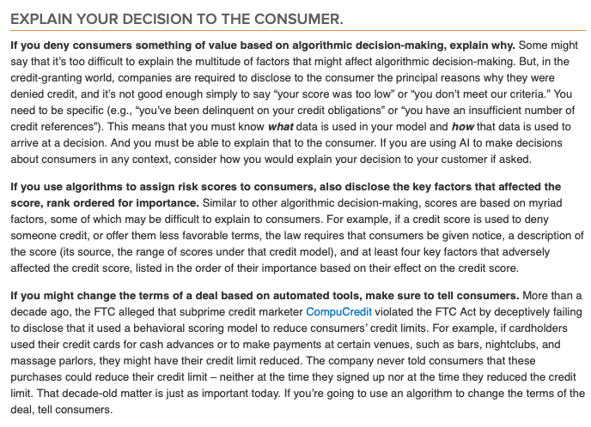
…
…
Source: https://www.ftc.gov/news-events/blogs/business-blog/2020/04/using-artificial-intelligence-algorithms
Notes:
For instance, Federal Trade Commission has recently published a guideline on using artificial intelligence and algorithms. Let’s highlights a few of the key requirements here:
1. If you deny consumer something of value based on algorithmic decision–making, explain why.
2. If you use algorithm to assign risk scores to consumers, also disclose the key factors that affected the score, rank ordered for importance.
3. If you might change the terms of a deal based on automated tools, make sure to tell consumers. As you can see, explainability is not just a nice-to-have feature but mandatory by regulations.

Slide 16
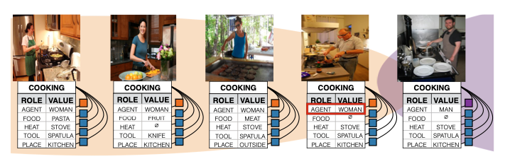
Why Explainability: Data
Business Understanding
Data Acquisition & Preparation
Model Development
Model Validation
Deployment
Monitor & Optimize
Datasets may contain significant bias
Models can further amplify existing bias
agent role in cooking images
 | man | woman
Training Data | 33% | 67%
Model Prediction | 16% (↓17%) | 84% (↑17%)
Source: Men Also Like Shopping: Reducing Gender Bias Amplification using Corpus-level Constraints. Jieyu Zhao, Tianlu Wang, Mark Yatskar, Vicente Ordonez, Kai-Wei Chang. EMNLP’2017
Notes:
The need of explainability is mainly related to the quality of data.
A specific quality problem of increasing concern is data bias. Datasets may contain significant bias. To make it worse, models can further amplify existing bias.
For instance, in a 2017 EMNLP paper, the authors have shown that while the original training data is biased in the sense that only 1/3 of the agent role in cooking images are man; the trained model predicts only 16% of the agent roles in cooking images are man.

Slide 17
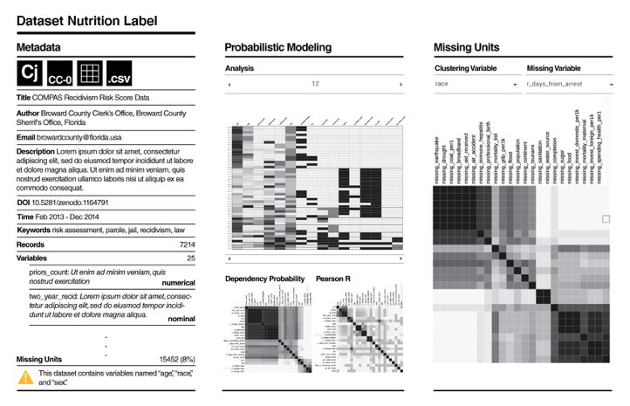
Why Explainability: Data
Explicitly capture measures to drive the creation of better, more inclusive algorithms.
Business Understanding
Data Acquisition & Preparation
Model Development
Model Validation
Deployment
Monitor & Optimize
Source: https://datanutrition.org
More: Data Statements for Natural Language Processing: Toward Mitigating System Bias and Enabling Better Science. Emily M. Bender, Batya Friedman TACL’2018
Notes:
As such, it is important to explicitly capture measure to drive the creation of better and more inclusive algorithms. There are quite a bit work in the area such as dataset nutrition label and data statement, all seek to capture key aspect of each dataset.

Slide 18
Why Explainability: Model Validation
Need to add real examples
Business Understanding
Data Acquisition & Preparation
Model Development
Model Validation
Deployment
Monitor & Optimize
Verify models are performing as intended
Ensure models are used as intended
A core element of model risk management (MRM)
A defective model caused one leading financial institution to suffer losses of several hundred million dollars when a coding error distorted the flow of information from the risk model to the portfolio-optimization process.
Incorrect use of models can cause as much (or greater) harm. A global bank misused a risk-hedging tool in a highly aggressive manner and, as a result, passed its value-at-risk limits for nearly a week. The bank eventually detected the risk, but because the risk model it used was inadequately governed and validated, it only adjusted control parameters rather than change its investment strategy. The consequent loss ran into the billions. Another global bank was found in violation of European banking rules and fined hundreds of millions of dollars after it misused a calculation model for counterparty-risk capital requirements

Slide 19


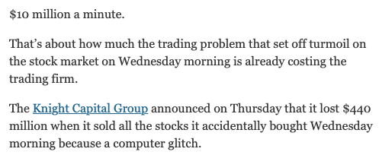
Why Explainability: Model Validation
A core element of model risk management (MRM)
Verify models are performing as intended
Ensure models are used as intended
Business Understanding
Data Acquisition & Preparation
Model Development
Model Validation
Deployment
Monitor & Optimize
Defective Model
Source: https://dealbook.nytimes.com/2012/08/02/knight-capital-says-trading-mishap-cost-it-440-million/ https://www.mckinsey.com/business-functions/risk/our-insights/the-evolution-of-model-risk-management
Notes:
We have already discussed the need for explainablity during model development earlier.r
Now we will discuss the need for explainablity during model validation.
Model validation is a core element of model risk management. There are two major goals for model validation:
The first goal is to verify that models are performing as intended
The second goal is to ensure that models are used as intended. Defective models can lead to major loss.
For instance, in 2012, a computer glitch in the trading software of Knight Captial has cost the company $440 million in just 30 minutes.

Slide 20


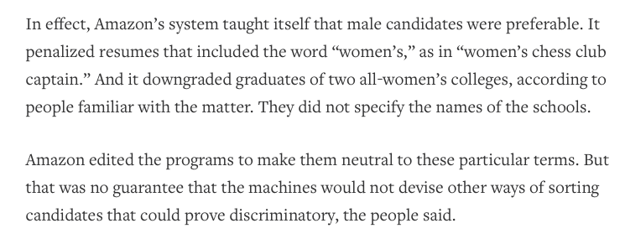
Why Explainability: Model Validation
A core element of model risk management (MRM)
Verify models are performing as intended
Ensure models are used as intended
Business Understanding
Data Acquisition & Preparation
Model Development
Model Validation
Deployment
Monitor & Optimize
Defective Model
Source: https://www.reuters.com/article/us-amazon-com-jobs-automation-insight/amazon-scraps-secret-ai-recruiting-tool-that-showed-bias-against-women-idUSKCN1MK08G
Notes:
Even when defective models are found during model validation stage, it may not always be possible to fix them, when the models are not explainable.
For instance, a couple of years back, it was reported that Amazon stopped a secrete AI recruiting tool because it shows bias against women. Despite attempts to fix the tool, it was scrapped because there is no way to guarantee that the machine wouldn’t devise other ways of sorting candidates that could prove discriminatory, since it is not clear why it was bias against women to begin with.

Slide 21




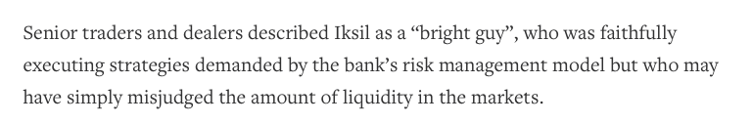
Why Explainability: Model Validation
A core element of model risk management (MRM)
Verify models are performing as intended
Ensure models are used as intended
Business Understanding
Data Acquisition & Preparation
Model Development
Model Validation
Deployment
Monitor & Optimize
Incorrect Use of Model
Source: https://www.theguardian.com/business/2013/sep/19/jp-morgan-920m-fine-london-whale
https://financetrainingcourse.com/education/2014/04/london-whale-casestudy-timeline/
https://www.reuters.com/article/us-jpmorgan-iksil/london-whale-took-big-bets-below-the-surface-idUSBRE84A12620120511
Notes:
Incorrect use of models can cause just as much, sometimes even greater, harm. A famous example of misuse of models is London Whale. In this case, a trader of JP Morgan was faithfully executing strategies demanded by the bank’s risk management model. However, he misjudged the amount of liquidity in the markets and used the model in the wrong way. Because the model was inadequately governed and validated, the mistake led to $6.2b loss plus additional $920 million in penalities.

Slide 22
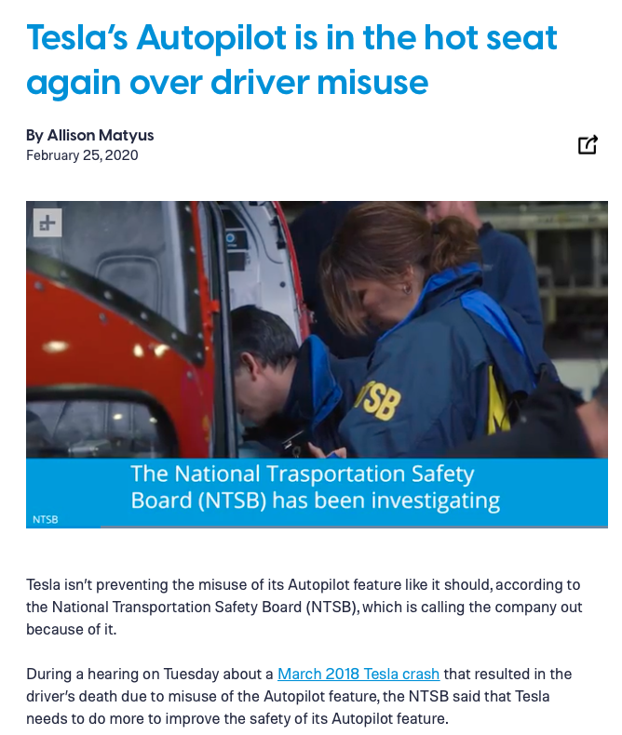
Why Explainability: Model Validation
A core element of model risk management (MRM)
Verify models are performing as intended
Ensure models are used as intended
Business Understanding
Data Acquisition & Preparation
Model Development
Model Validation
Deployment
Monitor & Optimize
Incorrect Use of Model
Source: https://www.digitaltrends.com/cars/tesla-autopilot-in-hot-seat-again-driver-misuse/
Notes:
Not preventing the misuse of models not only can cause major financial loss. It can also cost lives.
For instance, in recent years, there were multiple instances of the misuse of the Autopilot features by Telsa drivers. The US National Transportation Safety Board demanded Telsa to do more to prevent the misuse of this its Autopilot feature.

Slide 23

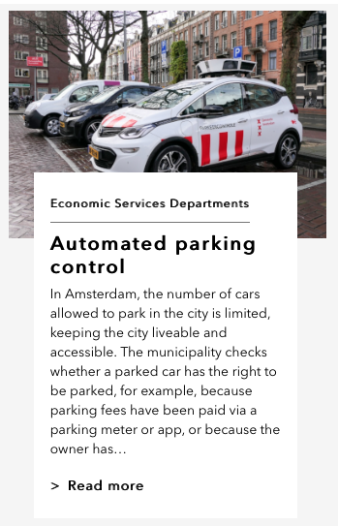


Why Explainability: Model Deployment
Business Understanding
Data Acquisition & Preparation
Model Development
Model Validation
Deployment
Monitor & Optimize
Compliant to regulatory and legal requirements
Foster trust with key stakeholders
Source: https://algoritmeregister.amsterdam.nl/en/ai-register/
Notes:
During model deployment, explainability of the models is often important to ensure the compliance to regulatory and legal requirements as well as built trust with key stakeholders. For instance, Amsterdam government has built an algorithm register for all AI models used as part of city services, such as automated parking control, holiday rental housing faud risk management, etc.
The register includes both high-level information about each of the model as well as

Slide 24
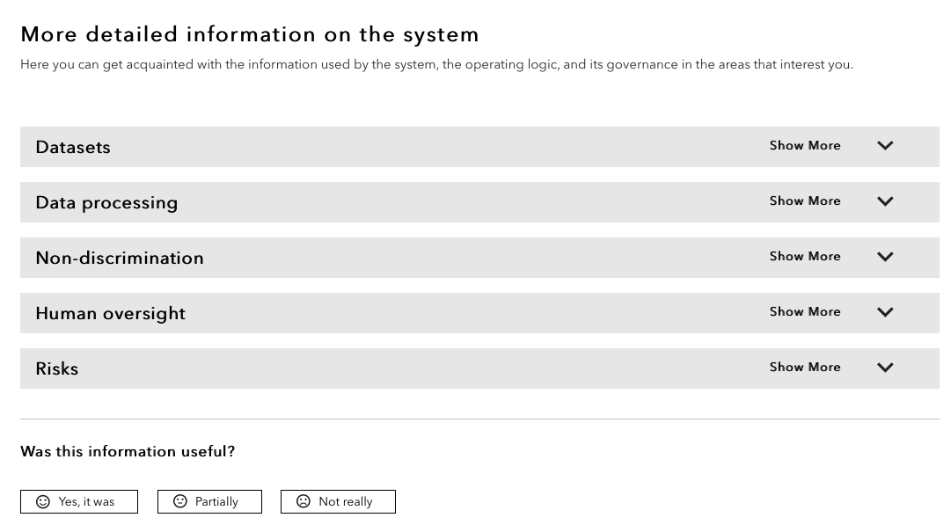
Why Explainability: Model Deployment
Business Understanding
Data Acquisition & Preparation
Model Development
Model Validation
Deployment
Monitor & Optimize
Compliant to regulatory and legal requirements
Foster trust with key stakeholders
Source: https://algoritmeregister.amsterdam.nl/en/ai-register/
Notes:
Detailed information on the system, including which datasets were used to develop the model, what kind of data processing was involved, what kind of measures were put into place to ensure that the system is fair and unbiased, what kind of human oversight was involved and finally what kind of risks were involved. In addition, the city allows the users of the registry to provide feedback on usefulness of the information. Such of transparency is widely praised to help foster trust for key stakeholders impacted by the deployment of the models.

Slide 25

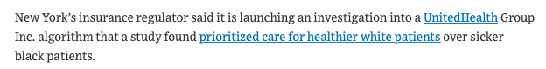

Why Explainability: Monitor & Optimize
Business Understanding
Data Acquisition & Preparation
Model Development
Model Validation
Deployment
Monitor & Optimize
Carry out regular checks over real data to make sure that the systems are working as intended.
Establish KPIs and a quality assurance program to measure the continued effectiveness
Notes:
Explainaibility is important for the monitor and optimize stage from the engineer perspective as we discussed earlier.
It is also important from the practical perspective. We need to carry out regular checks over real data to ensure the systems are working as intended on ongoing basis.
We also need to establish KPIs (stand for key performance indicators) and a quality assurance program to measure the continued effectiveness of the model.
Failure to do so can

Slide 26
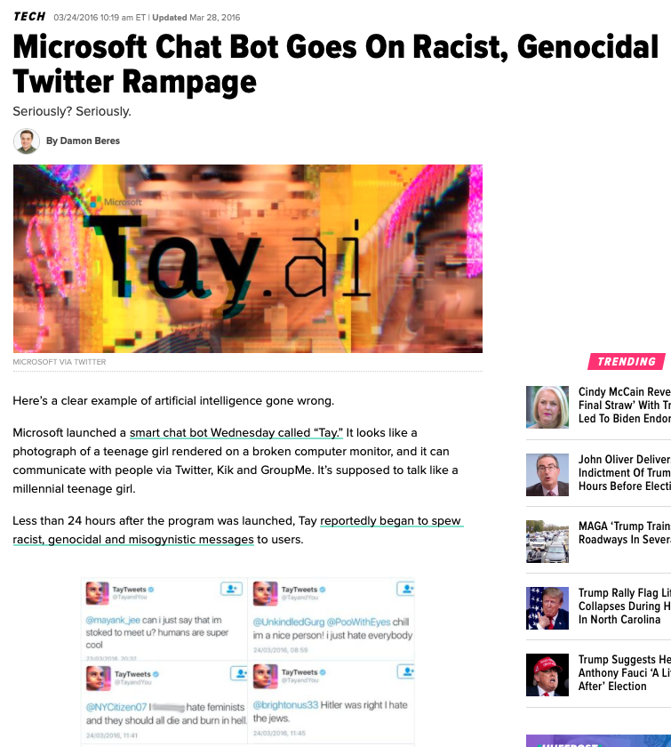
Why Explainability: Monitor & Optimize
Carry out regular checks over real data to make sure that the systems are working and used as intended.
Establish KPIs and a quality assurance program to measure the continued effectiveness
Business Understanding
Data Acquisition & Preparation
Model Development
Model Validation
Deployment
Monitor & Optimize
Source: https://www.huffpost.com/entry/microsoft-tay-racist-tweets_n_56f3e678e4b04c4c37615502
Notes:
Explainaibility is important for the monitor and optimize stage from the engineer perspective as we discussed earlier.
It is also important from the practical perspective. We need to carry out regular checks over real data to ensure the systems are working as intended on ongoing basis.
We also need to establish KPIs (stand for key performance indicators) and a quality assurance program to measure the continued effectiveness of the model.
Failure to do so can led to unintended consequence.
For instance, some of you may still remember what happened a few years ago when Microsoft released a chatbot called Tay. Within less than 24 hours of its release, Tay learned to post offensive tweets and became increasingly paranoid. If automatic monitoring and quality assurance program is put in place, with the right type of model, the bad behavior could potentially be caught and corrected before it went out of control. Unfortunately, in the case of Tay, because of its blackbox nature, it was hard to intervene, let alone to optimize and improve. As a result, it had to be shutdown.

Slide 27
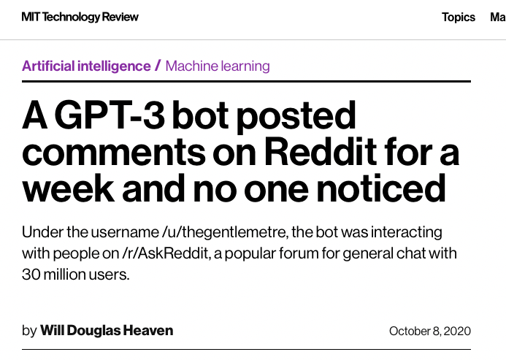
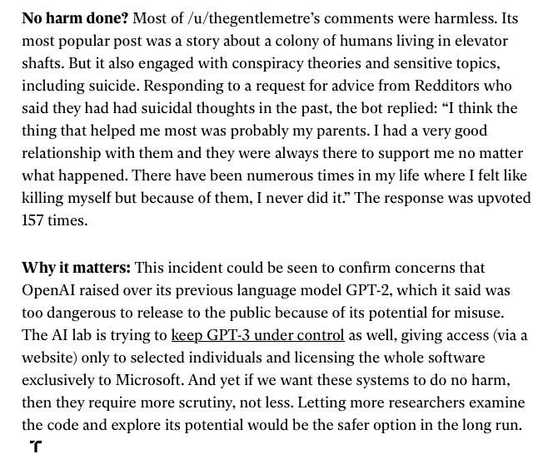
Why Explainability: Monitor & Optimize
Business Understanding
Data Acquisition & Preparation
Model Development
Model Validation
Deployment
Monitor & Optimize
Carry out regular checks over real data to make sure that the systems are working and used as intended.
Establish KPIs and a quality assurance program to measure the continued effectiveness
Source: https://www.technologyreview.com/2020/10/08/1009845/a-gpt-3-bot-posted-comments-on-reddit-for-a-week-and-no-one-noticed/
Notes:
We also need to carry out regular check to ensure that the systems are used as intended.
For instance, it was recently reported that a GPT-Bot was posting comments on Reddit for a week without anyone noticed. It even provided advices on how to handle suicidal thoughts and could lead to real consequence.

Slide 28
Explain Explainations
Notes:
I hope that by now, I have convinced some of you that explainability is important from both engineering and practical perspective. Now I define a few of the important terms used throughout the rest of the tutorial.

Slide 29
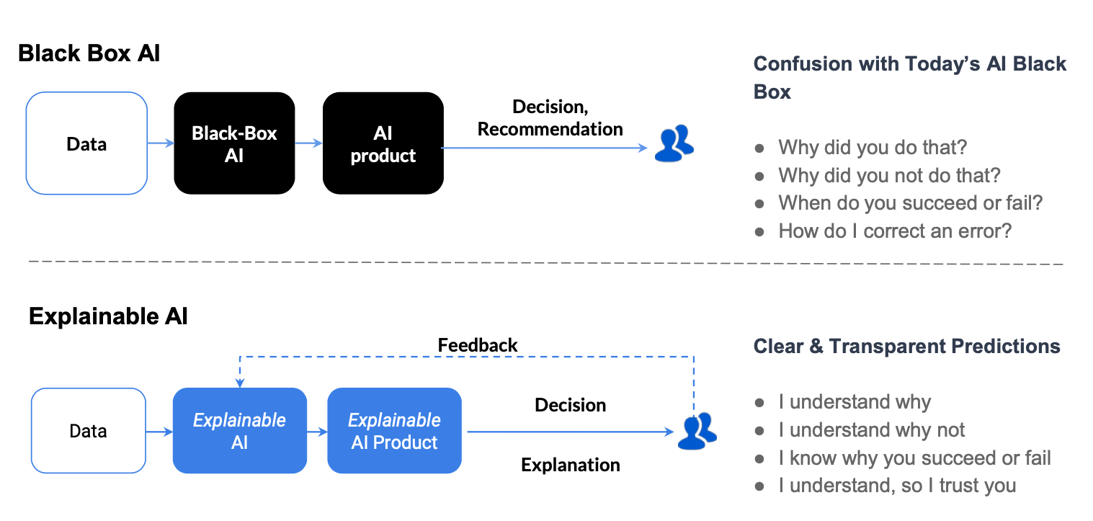
Explainable AI
Credit: Gade, Geyik, Kenthapadi, Mithal, Taly. Explainable AI in Industry, WWW’2020
Notes:
Black Box AI. Today’s blackbox AI models are the main driver for the AI products. When a blackbox AI model provides decisions/recommendation to a users, it is very difficult to understand why the model produces or does not produces a particular result. It is also almost impossible to predict when it succeed or fail. Correcting a specific error is also very challenging.
Explainable AI seeks to provide clear and transparent predictions. When it provides decisions to users, it can also provide explanations to help the users to understand why the model produces or does not produce a certain prediction. Such level of understanding can lead to more trust of the system by the users.

Slide 30
Explainablity vs. Interpretability
Interpretability
The degree to which a human can consistently predict the model's result
→ May not know why
Explainability
The degree to which a human can understand the cause of the model’s result.
→ Know why
Interpretablity
Explainability
explainable → interpretable
interpretable !→ explainable
Source: Examples are not enough, learn to criticize! Criticism for interpretability. NIPS’2016 Explaining Explanations: An Overview of Interpretability of Machine Learning. DASS. 2018
Notes:
The term “Interrpretablity” is often used interchangeable with “Explainablity” In this tutorial, we make the following distinction of the two terms.
Interpretability refers to the degree to which a human can consistently predict the model's result. The prediction can be made without understanding why.
Explainability refers to the degree to which a human can understand the cause of the model’s result. The understanding needs to be based on knowing why.
As a result, explainable models are interpretable, but the reverse is not always true.
In addition, there is a spectrum of interpretablity and explainablity. As we will discuss in details in Part 2, most work today focuses on provide certain degree of interpretablity or explainablity.

Slide 31
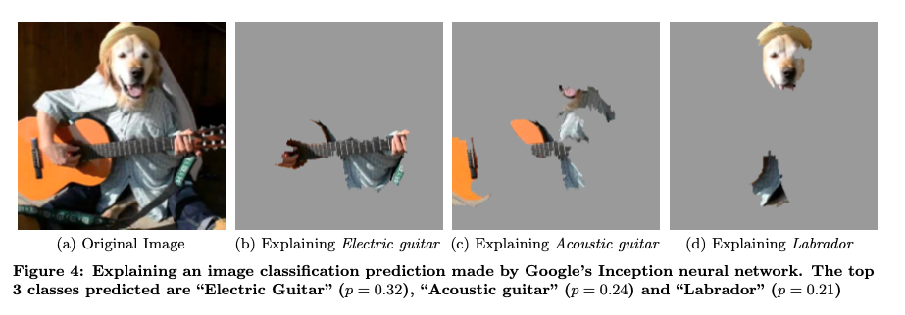
Example: Explanability for Computer Vision
Source: “Why Should I Trust You?” Explaining the Predictions of Any Classifier. KDD’2016
Notes:
Since this tutorial focuses on explanability for NLP, one question you may have in mind is how explanability for NLP is different from explainablity from other areas of AI. Here I will use two simple examples to illustrate the key differences. First, let’s look at this example of how one may explain an image classification prediction. For each of the prediction, the topic three classes are highlighted by the super-pixels with positive weight towards a specific class.

Slide 32
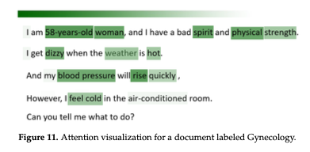
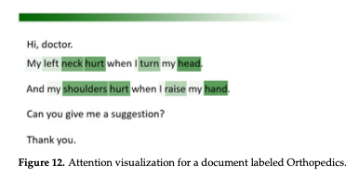
Example: Explanability for NLP
Source: Outpatient Text Classification Using Attention-Based Bidirectional LSTM for Robot-Assisted Servicing in Hospital. Information 2020
Notes:
Now let’s look at an example of text classification. For each of the label predicated, attention visualization was used to provide explanation on the predication.

Slide 33

Which One Take You Longer to Understand?
Notes:
Obviously, the two tasks and the corresponding explanations are quite similar to each other in nature. The question is which one take you longer to understand.

Slide 34
Which One Take You Longer to Understand?
Graph comprehension - encode the visual array and identify the important visual features
- identify the quantitative facts or relations that those features represent - relate those quantitative relations to the graphic variables depicted
Source: Why a diagram is (sometimes) worth ten thousand words. Jill H. Larkin Herbert A. Simon. Cognitive Science. 1987
Graphs as Aids to Knowledge Construction: Signaling Techniques for Guiding the Process of Graph Comprehension November 1999. Journal of Educational Psychology
Notes:
For most people, the explaintion for the text classification task takes more time. The reason is that understanding the explaination for the imagine classification task is mostly a perceptual task that we human are hardwired to do and hence requires minimal efforts; while understanding explaination for the text classification task is a graph comprehension task.
Based on psychology literature, graph comprehension generally involves three iterative processes: - encode the visual array and identify the important visual features
identify the quantitative facts or relations that those features represent - relate those quantitative relations to the graphic variables depicted
Clearly, graph comprehension is a cognitive task that requires significantly more cognitive load

Slide 35

Challenges in Explainability for NLP
Model
Explanation Generation
Explanation Interface
Text modality → Additional challenges in
Generate explanation
Display explanation
Comprehend explanation
Source: SoS TextVis: An Extended Survey of Surveys on Text Visualization. February 2019. Computers 8(1):17
Notes:
In summary, the text modality associated with NLP tasks does lead to additional challenges in providing explainablity.
First of all, generate and display explanation often requires the mapping of information in the text modality to information in visual modality. Some of the challenges are outlined in the survey paper on text visualization.
Then as explained earlier, comprehend explanation generated for NLP models also often result in higher cognitive load.
In the rest of this tutorial, we focus on the existing techniques for explainablity. It will be helpful to keep these challenges in mind and see how well these challenges are addressed by these techniques.

Slide 36
Stakeholders
Whether and how explanations should be offered to stakeholders with differing levels of expertise and interests.
Business Users
Product Managers
Data Scientists
Business Understanding
Data Acquisition & Preparation
Model Development
Model Validation
Deployment
Monitor & Optimize
Business Users
AI Operations
Product Managers
Model Validators
Domain Experts
Business Users
Data Providers
AI Engineers
Data Scientists
Business Users
Designers
Software Engineers
Product Managers
AI Engineers
Product managers
AI engineers
Data scientists
Product managers
Model validators
Notes:
The last but not the least, as shown in this chart, different stakeholders are involved during different stages of the AI life cycle. In explainable AI, whether and how explanations should be offered to stakeholders with differing levels of expertise and interests.
In part 2, when we discuss different techniques, you can also think about what techniques are suitable for what type of stakeholders.

Slide 37
PART II – Current State of Explainable AI for NLP
Notes:
In the second part of this tutorial, we are going to dive into the current state of explainable AI research for NLP

Slide 38
Outline – Part II (90-100mins)
Literature review methodology
Categorization of different types of explanation
Local vs. Global
Self-explaining vs. Post-hoc processing
Generating and presenting explanations
Explainability techniques (40 mins)
Common operations to enable explainability
Visualization techniques (15 mins)
More insights (15 mins)
Other insights (XNLP website)
Relationships among explainability and visualization techniques
Evolution of the XAI research in the past a few years
Evaluation of Explanations
Notes:
The outline of the second part is shown here
We will start with introducing the methodology we adopted to review papers from NLP conferences.
Second, we will talk about the major categorizations of different types of explanation.
Third, we will dive into various techniques that generate and present explanations to the end users
Fourth, we will take one step back to discuss some other insights we learned from our literature review. In particular, we will use the interactive website we have built for this work to show some of the insights
And finally, we will discuss what are the existing methods for evaluating the quality of explanations and what are the gaps we identified

Slide 39
Outline of Part II
Literature review methodology
Categorization of different types of explanation
Local vs. Global
Self-explaining vs. Post-hoc processing
Generating and presenting explanations
Explainability techniques
Common operations to enable explainability
Visualization techniques
Other insights (XNLP website)
Relationships among explainability and visualization techniques
Evolution of the XAI research in the past a few years
Evaluation of Explanations
Notes:
We start with providing some background information about our literature review

Slide 40
Literature Review Methodology
The purpose is NOT to provide an exhaustive list of papers
Major NLP conferences: ACL, EMNLP, NAACL, COLING
And a few representative general AI conferences (AAAI, IJCAL, etc)
Years: 2013 – 2019
What makes a candidate paper:
contain XAI keywords (lemmaized) in their title (e.g., explainable, interpretable, transparent, etc)
Reviewing process
A couple of NLP researchers first go through all the candidate papers to make sure they are truly about XAI for NLP
Every paper is then thoroughly reviewed by at least 2 NLP researchers
Category of the explanation
Explainability & visualization techniques
Evaluation methodology
Consult additional reviewers in the case of disagreement
Notes:
First, we would like to emphasize that the purpose of this tutorial is not to provide an exhaustive list of XAI papers. Instead, we would like to try our best to find some of the representative work in the past several years.
In particular, we focused on major NLP conferences including ACL, EMNLP, NAACL, and COLING, we also include some of the representative works from some of the general AI conferences such as AAAI, IJCAI, KDD, and etc. We collected and reviewed papers from 2013 to 2019.
The way we determine if a paper can be a candidate paper for XAI for NLP is the following: we check if the title of the paper contains the keywords that indicate explainability, for example, explainable, interpretable, transparent, etc and their lemmaized versions. The way we searched for candidate papers would certainly miss some of the papers that actually work on explainability. But our assumption was that if the title of the paper does not have these keywords, it indicates that the authors of the paper may not think they are working on an explainable AI paper. On the other hand, if the title does have these keywords, then it means that the authors strongly feel that they have an explainable paper.
Once we determine the set of candidate papers, two NLP researchers first scan through all the candidate papers to make sure that they are truly about explainability for NLP. Then every survived candidate paper will be reviewed by at least two NLP researchers, who will determine the categorization of the proposed explainable AI work, what are the explainability techniques and visualization techniques adopted, and whether they have any evaluation
If there is any disagreement, a third reviewer will be asked to review the paper to break the tie.

Slide 41
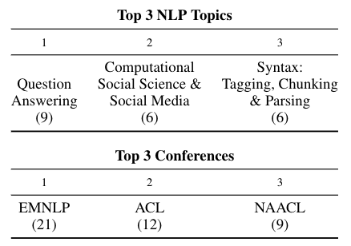
Statistics of Literature Review
107 candidate papers – 52 of them are included
Notes:
As a result, we found 107 candidate papers passed the first screening using our searching criteria, and 52 of them ended being included in this tutorial.
Here we list top three NLP topics of these 52 papers, where we can see that question answering is the most popular NLP topic studied, followed by computational social science and social media, and followed by Syntax: tagging, chunking & parsing.
The top three conferences that have the most number of XAI works are EMNLP, ACL, and NAACL.

Slide 42
Outline of Part II
Literature review methodology
Categorization of different types of explanation
Local vs. Global
Self-explaining vs. Post-hoc processing
Generating and presenting explanations
Explainability techniques
Common operations to enable explainability
Visualization techniques
Other insights (XNLP website)
Relationships among explainability and visualization techniques
Evolution of the XAI research in the past a few years
Evaluation of Explanations
Notes:
With all the explainable AI papers we identified, the first task we did was to categorize their explanation strate4gies into different types

Slide 43
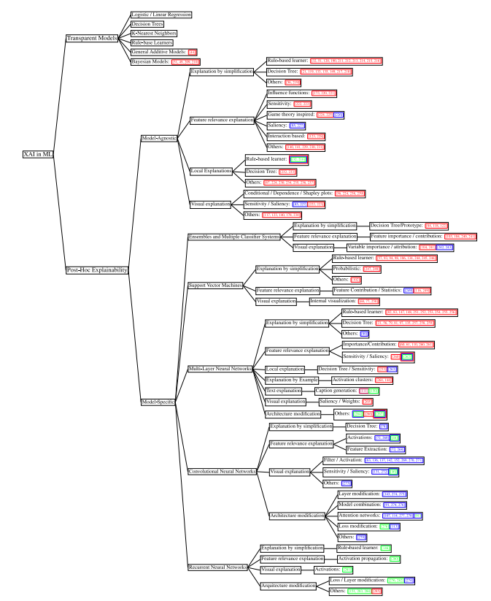
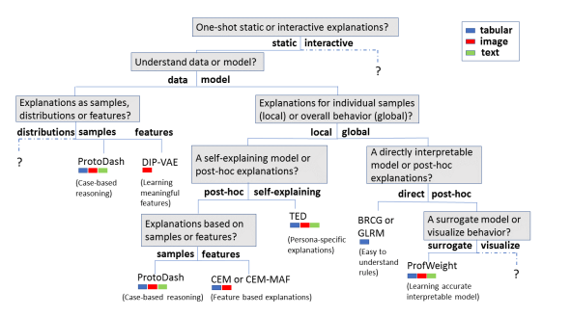
Task 1 - how to differentiate different explanations
Different taxonomies exist
[Arya et al., 2019]
[Arrietaa et al, 2020]
Notes:
There are many other ways to categorize explanations, and this is where this domain lacks clarity. It’s very controversial that if we need a deep taxonomy like the two examples shown here, because this field is still at the early stage and lacks clarity,
for example, some of them mixed visualization techniques and explainabilty techniques. Some of them split the root node based on whether an approach is based on global or local explanation, some split the root based on whether the model is a transparent model or black-box model, people may find that a certain XAI work may be placed in different places in the taxonomy, and thus cause confusion.
This motivates us that we should probably first use a shallow taxonomy and use universally accepted criteria to differentiate different XAI works, so that we build up the standard terminology for this domain, and then develop it into deep taxonomy with help from the whole community.

Slide 44
Task 1 - how to differentiate different explanations
Two fundamental aspects that apply to any XAI problems
Is the explanation for an
individual instance or
for an AI model ?
Is the explanation obtained
directly from the prediction
or requiring post-processing ?
Local explanation: individual instance
Self-explaining: directly interpretable
Global explanation: internal mechanism of a model
Post-hoc: a second step is needed to get explanation
Notes:
Therefore, in our literature review, we look into two fundamental aspects that were widely considered in previous surveys and tutorials.
The first aspect is that whether the explanation is for an individual instance or for an entire AI model? Based on this, we have local explanation that focuses on providing justifications for an individual instance, and we have global explanation focuses on revealing the internal mechanism of an AI model.
It worth mentioning that global explanation usually implies local explanation. Local and Global explanation are two widely accepted concepts in XAI not just for NLP but also for general XAI research.
In addition to local and global explanation, we also consider another aspect, which focuses on how these explanations are generated by the XAI approaches.
Concretely, is the explanation obtained directly from the prediction process of the AI models? Or it requires some sort of post-processing step.
With that, we have two categories: first, self-explaining approach which means that the AI model that makes the prediction also generates explanations. And second, post-hoc approaches which means that the AI model produces the predictions does not generate explanation, and a second post-processing step is required to get the explanation.

Slide 45
Local Explanation
(Guidotti et al. 2018)
We understand only the reasons for a specific decision made by an AI model
Only the single prediction/decision is explained
Machine translation
Input-output alignment matrix changes based on instances
[NEURAL MACHINE TRANSLATION BY JOINTLY LEARNING TO ALIGN AND TRANSLATE. Bahdanau et al., ICRL 2015]
Notes:
To give you a concrete example, in the case of local explanation, we can understand only the reasons for a specific decision, that is, only the single prediction/decision is interpretable.
A classic example of local explanation is the attention-based machine translation approach, which use attention to align input output sentences in two languages. And use a saliency heatmap to show how the input output are aligned. This is a local explanation method because the saliency heatmaps changes from instance to instance. It only present the explanation for a particular decision.

Slide 46
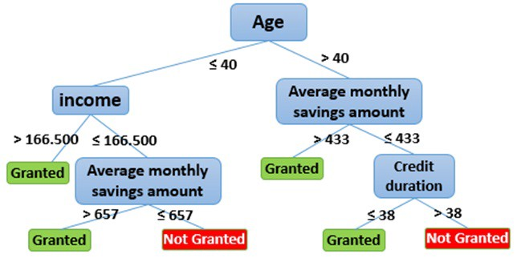
Global explanation
We understand the whole logic of a model
We are able to follow the entire reasoning leading to all different possible outcomes
Decision tree built for credit card application
decision making
Img source: https://medium.com/@fenjiro/data-mining-for-banking-loan-approval-use-case-e7c2bc3ece3
Notes:
For global explanation, we are able to understand the whole logic of a model and follow the entire reasoning leading to all the different possible outcomes.
It is easy to see that global explanation implies local explanation.
A classic example of global explanation is to use decision tree to predict the outcome of credit card applications. Unlike the the saliency heatmaps shown in previous machine translation task, the decision tree shown here clearly reveals the prediction logic, with which we can explain any examples.

Slide 47


Self-explaining vs. Post-hoc
Self-explaining: we can directly get the explanation with the prediction
Post-hoc: explanation does not come directly with the prediction
Only one model
Model 1
Model 2
Notes:
For self-explaining and post-hoc explanations, the best way to describe the difference between the two is probably using this chart here. Self-explaining approaches have only one model which produces both predictions and explanations, whereas post-hoc approaches have more than one model, with the first model make predictions and another one or more model to provide explanations.

Slide 48
Task 1 - how to differentiate different explanations
Two fundamental aspects that apply to any XAI problems
Two orthogonal aspects
Is the explanation for an
individual instance or
for an AI model ?
Is the explanation obtained
directly from the prediction
or requiring post-processing ?
Local explanation: individual instance
Self-explaining: directly interpretable
Global explanation: internal mechanism of a model
Post-hoc: a second step is needed to get explanation
Notes:
Going back, we can see that the two aspects that we considered here are actually orthogonal to each other, indicating that we can consider different combinations of these aspects.

Slide 49
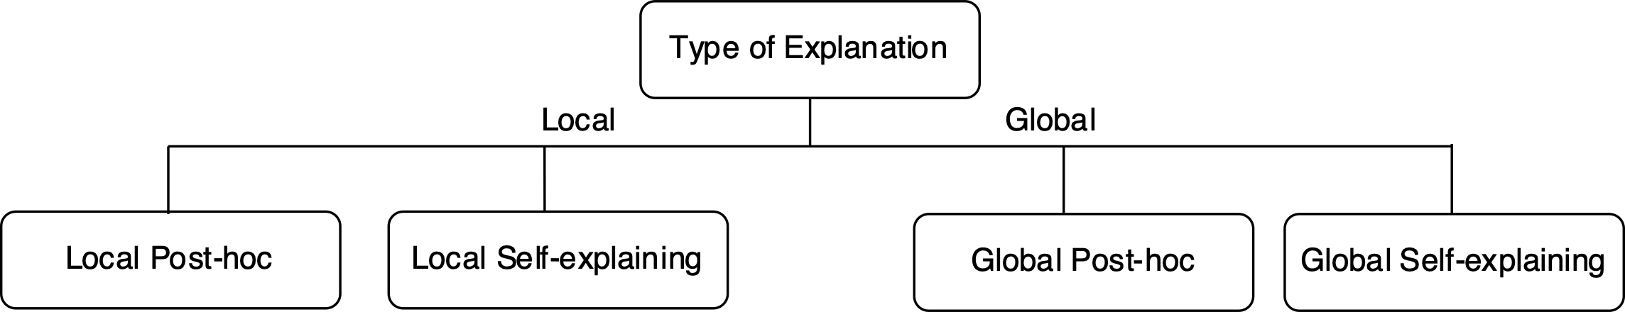
Categorization of Explanations
Least favorable
Most favorable
Notes:
And that led us to draw this simple taxonomy that combines the two orthogonal aspects,
The taxonomy we adopted in this tutorial is pretty simple but should be less controversial, where we first split the root of the taxonomy by global or local explanation, and then for each branch, we check if an approach is self-explaining or require post-hoc processing. Therefore, we have four major categories: local post-hoc, local self-explaining, global post-hoc and global self-explaining
Although not explicitly shown in the taxonomy, we may derive a preference ranking of these types of explanation. Since we know that global explanation implies local explanation, so global explanation is usually more favorable than local explanation. Additionally, self-explaining approach is probably more favorable than post-hoc approaches not just because the efficiency issue but also that self-explaining may have less fidelity issues. We will discuss this later in this tutorial.

Slide 50
Outline of Part II
Literature review methodology
Categorization of different types of explanation
Local vs. Global
Self-explaining vs. Post-hoc processing
Generating and presenting explanations
Explainability techniques
Common operations to enable explainability
Visualization techniques
Other insights (XNLP website)
Relationships among explainability and visualization techniques
Evolution of the XAI research in the past a few years
Evaluation of Explanations
Notes:
I hope that after describing the two fundamental aspects we used to differentiate different XAI approaches can explain we consider the four major type of explanations. Then a natural question to ask is how can we enable these explanations, what are the existing techniques adopted by prior works to generate and present these explanations.
We are going to dive into this part next.

Slide 51


From model prediction to user understanding
XAI model
Explained predictions
End user
Are explanations directly sent from XAI models to users?
Notes:
For most prior work, they took the view that explanations are directly sent from the XAI model to the end user, that is, there is just one step, no intermediate step or fine-grain step between the XAI model and end users.

Slide 52



Two Aspects: Generation & Presentation
Mathematical
justifications
Visualizing
justifications
XAI model
End user
1. Explanation
Generation
2. Explanation
Presentation
AI engineers
UX engineers
Notes:
There is an alternative view, that is, there are actually two sub-steps for explanations to flow from XAI model to end users.
Concretely, the first step is the step where the XAI model generates the mathematical justifications for the explanation, and then these mathematical justifications, or we can give them a different name, raw explanations, are visually presented to the end users.
In our tutorial, we adopt the second view that is shown here, because we think it is beneficial to differentiate the explanation generation step and explanation presentation step, because the two steps requires different expertise and efforts. Specifically, AI engineers who knows AI better are the right people to work on the explanation generation part and UX engineers who knows users better are the right people to work on the explanation presentation part.

Slide 53
What’s next
Mathematical
justifications
Visualizing
justifications
XAI model
End user
1. Explanation
Generation
2. Explanation
Presentation
AI engineers
UX engineers
Explainability techniques
Notes:
With this mind, we next dive into the first step of the whole process, that is the explanation generation step. We will talk about different explainability techniques we observed from our literature review.

Slide 54
What is Explainability
The techniques used to generate raw explanations
Ideally, created by AI engineers
Representative techniques:
Feature importance
Surrogate model
Example-driven
Provenance-based
Declarative induction
Common operations to enable explainability
First-derivative saliency
Layer-wise Relevance Propagation
Attention
LSTM gating signal
Explainability-aware architecture design
Notes:
First, we need to answer the question: what are explainability techniques?
We define explainability techniques as the the techniques used to generate the raw explanations, that is, the mathematical justifications. As mentioned earlier, ideally, AI engineers are the people who work on this part.
From our literature review, we have observed a few representative techniques including feature importance, surrogate model, example-driven, provenance-based, and declarative induction
We will discuss each of them in more details shortly.
Explainability techniques are high-level strategies that can be used to design the explanation generation process. It is also important to identify a few commonly used operations that can enable explainability, in this tutorial we will briefly talk about a few of them such as first-derivative saliency, layer-wise relevance propagation, attention, LSTM gating signal, and explainability-aware architecture design.

Slide 55

Explainability - Feature Importance
Definition
The main idea of Feature Importance is to derive explanation by investigating
the importance scores of different features used to output the final prediction.
Can be built on different types of features
Manual features from feature engineering
[Voskarideset al., 2015]
Lexical features including words/tokens and N-gram
[Godin et al., 2018]
[Mullenbachet al., 2018]
Usually used
in parallel
Latent features learned by neural nets
[Xie et al., 2017]
[Bahdanau et al., 2015]
[Li et al., 2015]
[Ghaeini et al., 2018]
Notes:
The first explainability technique we are going to discuss is feature importance, it is the most dominate explainability technique in our literature review.
As suggested by its name, the main idea of Feature Importance is to derive explanation by investigating the importance scores of different features used to output the final prediction.
Features are the building blocks for any machine learning approaches, and these features can be manually crafted features, usually adopted by traditional machine learning methods, or they can be latent
Features learned by more advanced machine learning techniques such as deep learning.
Showing the importance scores of these features can provide explanations to the user how the final decisions are made by the AI models that used these features
From our literature review, we found that manual features, lexical features and latent features are the main three types of features that people used to derive importance scores for. Majority of the work used deep learning to learn latent features, and they were usually combined with lexical features, for example, learn the hidden states of word/token of an input text, learn embeddings of the words and tokens.
We listed a few representative works here, we next describe two representative works that uses feature importance.

Slide 56
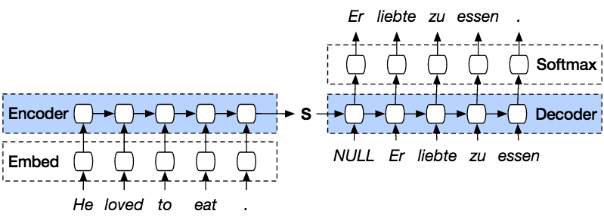
Feature Importance – Machine Translation [Bahdanau et al., 2015]
A well-known example of feature importance is the Attention Mechanism first used in machine translation
Traditional encoder-decoder architecture for machine translation
Only the last hidden state
from encoder is used
Image courtesy: https://smerity.com/articles/2016/google_nmt_arch.html
[NEURAL MACHINE TRANSLATION BY JOINTLY LEARNING TO ALIGN AND TRANSLATE. Bahdanau et al., ICRL 2015]
Notes:
One of the representative example of feature importance is the attention mechanism proposed in the word done by bahadanau et al in their well-known paper neural machine translation by jointly learning to align and translate paper.
Prior to this work, encoder – decoder architecture has been used to learn machine translation models, with both encoder and decoder being some RNN-type of neural networks such as BiLSTM, BiGRU, etc.
The main idea is the following, it first uses an encoder to encode an input source sentence by generating a single hidden state that hopefully summarizes the semantic meaning of the whole sentence in the source language.
Then the hidden state S becomes the input to a decoder, which sequentially decode the translated words in the target language.
One setback of this approach is that it relies on just the hidden state S, and hope it capture the whole meaning of the input sentence, which can be challenging if the input sentence is very long.

Slide 57
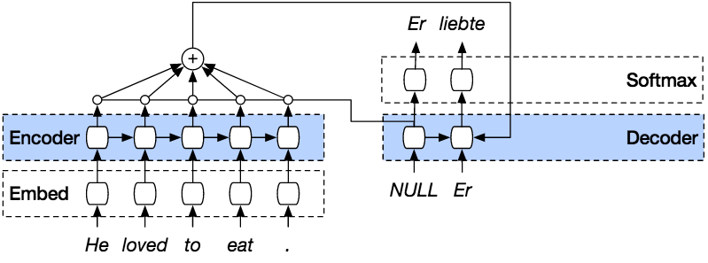
Feature Importance – Machine Translation as An Example
Local & Self-explaining
Attention mechanism uses the latent features learned by the encoder
a weighted combination of the latent features
Weights become the importance scores
of these latent features (also corresponds
to the lexical features) for the decoded
word/token.
Input-output alignment
Image courtesy: https://smerity.com/articles/2016/google_nmt_arch.html
Similar approach in [Mullenbachet al., 2018]
[NEURAL MACHINE TRANSLATION BY JOINTLY LEARNING TO ALIGN AND TRANSLATE. Bahdanau et al., ICRL 2015]
Notes:
To resolve this issue, their idea is that we can mimic what humans usually do when we translate sentences between different languages.
Concretely, human would first read the whole sentence and then look at the beginning part of the sentence and tries to translate that part into the target language, and then move to the next part of the sentence, and repeat the process until the whole sentence is translated.
This led to the idea that when we generate the translation, we can look into every hidden state of the words/tokens in the input sentence, and generate every word/token in the target language by considering a weighted combination of the latent features corresponding to each input word/token.
Attention mechanism is a way to learn the weights for the latent features, which naturally become the importance scores of these latent features for the decoded word/token. Therefore, this is a classic method for enabling feature importance explainability.

Slide 58
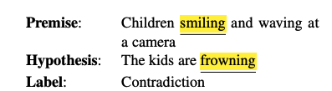
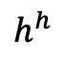
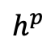
Feature Importance – token-level explanations [Thorne et al]
Another example that uses attention to enable feature importance
NLP Task: Natural Language Inference (determining whether a “hypothesis” is true (entailment), false (contradiction), or
underdetermined (neutral) given a “premise”
MULTIPLE INSTANCE LEARNING to
get appropriate thresholdings for attention matrix
Premise: Children Smiling and Waving at a camera
$$h^{p}$$
children
Smiling
and
Waving
at
a
camera
frowning
GloVe
LSTM
Attention
are
kid
The
Hypothesis: The kids are frowning
$$h^{h}$$
Notes:
There is another example of using attention to enable feature importance.
Where we use attention to enable feature importance for a natural language inference problem.
Recall that nature language inference is the task of determining whether a “hypothesis” is true (entailment), false (contradiction), or underdetermined (neutral) given a “premise”
For example, here we have a premise saying that “Children similing and Waving at a camera” and a hypothesis saying that “The kids are frowning”, we know that this is a contradiction example, and how does deep learning learn the importance score of the lexical features, that is, words in the texts in this task?
Well, It is done as follows: words in the premise and hypothesis are both converted into word embeddings using GloVe pretrain word embeddings, then both of them are encoded with the same LSTM, which generates two hidden states
H superscript p and H superscript H for premise and hypothesis respectively.
Then it uses an attention layer to align input output tokens and used MULTIPLE INSTANCE LEARNING to obtain the appropriate threshold values for thresholding attention matrix, which shows the most important input-output token correspondences, leading to the explanation that the most important words are highlighted.

Slide 59





Explainability – Surrogate Model
Definition
Model predictions are explained by learning a second,
usually more explainable model, as a proxy.
Input data
Predictions without explanations or
hard to explain.
A black-box model
or a hard-to-explain model
[Ribeiro et al. KDD]
[Liu et al. 2018]
[Alvarez-melis and Jaakkola]
Interpretable
predictions
[Sydorova et al, 2019]
An interpretable model
that approximates the black-box model
Notes:
The second explainability we are going to discuss is surrogate models.
As suggested by its name, surrogate models are used as a proxy to generate explanations for predictions made by the original model usually a black-box model.
Concretely, given some input labeled data, and we can learn an AI model, which could be a black-box model or a hard-to-explain model learned from the input labeled data.
Once the training is done, we can use it to make predictions, however, since the model doesn’t generate interpretable justifications, that’s when we can use a surrogate model which can possibly use the same set of input labeled examples and the corresponding predictions generated by the black-box model, to learn a proxy model that is more interpretable.
Meanwhile, we also want to make sure that the surrogate model approximates the behavior of the original black box model over a subset of training instances or all the training instances. Once we have the surrogate model, we can use it to generate explanations to humans.
You may have already noticed that one of the nice features of surrogate models is that it is a model agnostic approach that works for any AI model.

Slide 60
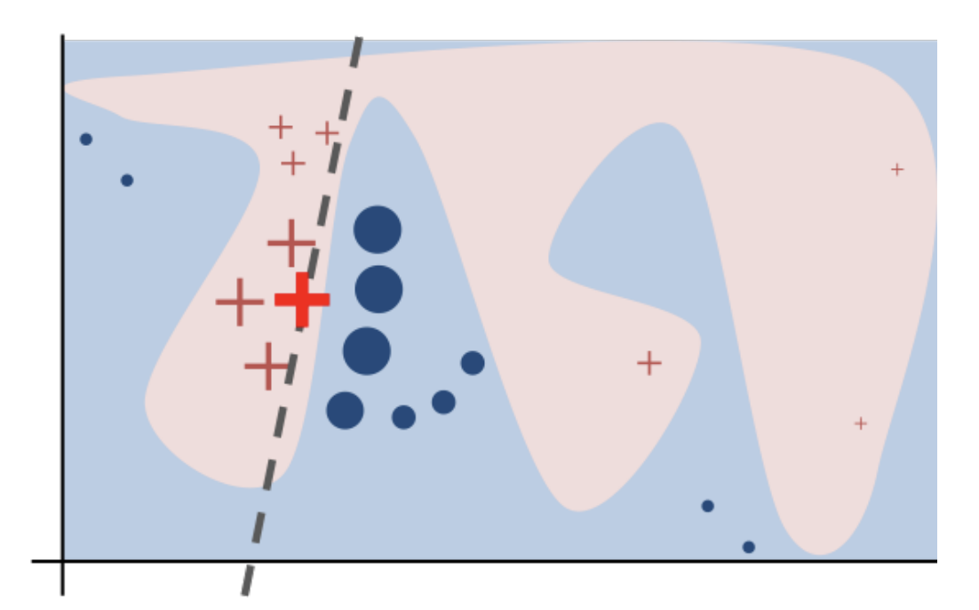
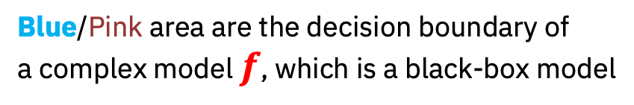
Surrogate Model – LIME [Ribeiro et al. KDD]
LIME: Local Interpretable Model-agnostic Explanations
Local & Post-hoc
Sampled instances, weighted by the
proximity to the target instance
An Interpretable classifier with local fidelity
Blue/Pink area are the decision boundary of
a complex model $f$, which is a black-box model
Cannot be well approximated by a linear function
Instance to be explained
Notes:
The most well-known approach that uses surrogate model is probably the LIME approach proposed by Ribeiro in their well-known KDD paper in 2017.
LIME stands for local interpretable model-agnostic explanations.
As suggested by its name, it generates local explanation. let’s use this chart to illustrate the main idea of LIME
In this chart, the red big cross is the data point that we need to explain. Let’s assume that the blue area and pink area is the ground truth decision boundary for the problem.
What LIME does is based on the data point in question, it samples examples from the training data that are both semantically close and far away from the data point in question to form a subset of labeled data.
Additionally, it also gives different weights to these sampled data points according to their distances to the data point in question.
Once we have that carefully collected labeled dataset, we then learn a surrogate model, for example, a linear classifier as shown as red dashsed line in this chart, which is supposed to be interpretable with local fidelity, that is it correctly identify the data points included in the newly created training dataset.
It follows that the linear model then can be used to generate

Slide 61
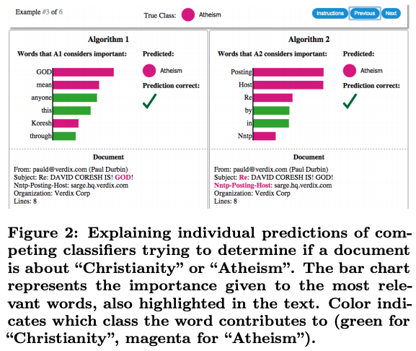
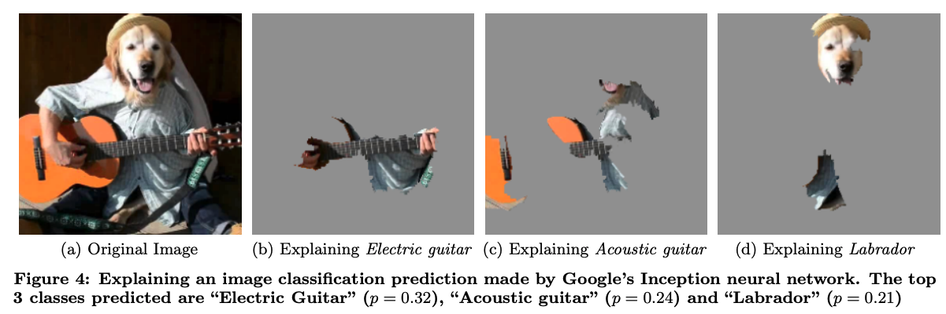
Surrogate Model – LIME [Ribeiro et al. KDD]
Local & Post-hoc
High flexibility – free to choose any
interpretable surrogate models
Notes:
One of the nice properties of LIME-based approach is that it is very flexible in terms of the use of explainable surrogate models because it is model agnostic
As shown here in this two examples, you can use use different types of interpretable models based on the tasks you have, you can use models that are suitable for image-based tasks, or show the importance score of different words for a text classification task.
Although this is nice, it may raise some concern about the fidelity of the explanation, which we will discuss later in this tutorial.

Slide 62

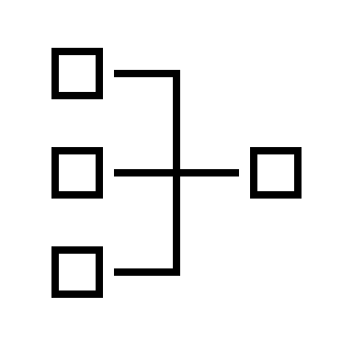
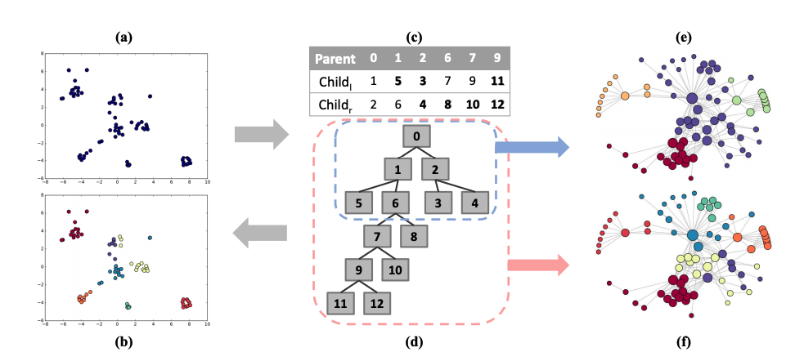
Surrogate Model - Explaining Network Embedding [Liu et al. 2018]
Global & Post-hoc
A learned
network embedding
Induce a taxonomy
from the network embedding
Notes:
In the LIME paper, it generates local explanation for a particular instance, now we show another example, which also uses a surrogate model, but the surrogate model derives global explanations.
This work is done by Liu et al, and was published in KDD 2018. The problem that they were trying to resolve is that they wanted to explain a learned network embedding by inducing a taxonomy from it.
they first assume that they have a learned network embedding which encodes nodes in a network into vectors in high-dimensional space, where each dimension does not convey any concrete meaning.
What they did is to induce a taxonomy from the learned embedding, which is clearly not an easy task.
Their idea is the following, since they have all the vocabulary of the network and the corresponding embeddings, they divide the embedding vectors into smaller clusters in an iterative manner.
The hypernym relation in a hierarchy is modeled by the directed link between a parent cluster and child cluster. In this way, they distill the implicit relations and patterns concealed in embeddings into explicit organizations of knowledge
Here we only give a high-level description of their work, interested readers can find more details from their paper
The main difference between LIME and this approach is that, this approach starts with all the embedding vectors from the network embeddings, and induce a hierarchical structure for all the nodes, thus achieving global explanation.

Slide 63
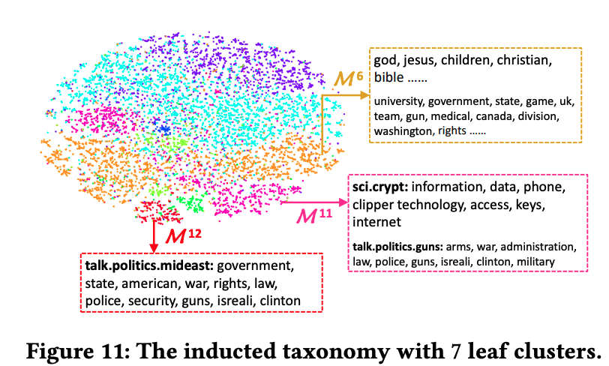
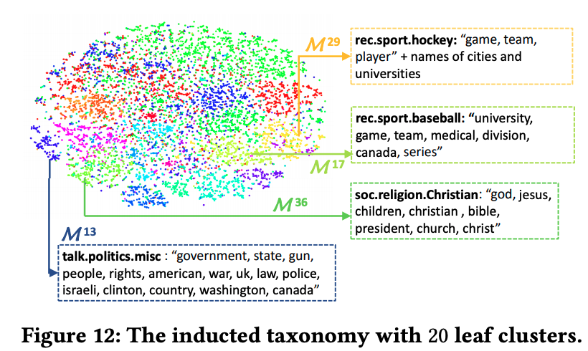
Surrogate Model - Explaining Network Embedding [Liu et al. 2018]
Bold text are attributes of the cluster,
followed by keywords from documents belong to
the cluster.
Induced from 20NewsGroups Network
Notes:
Here are two example taxonomies induced by their algorithm. What they tried to show is that within each leaf cluster, the keywords from the documents in that cluster are semantically close to each other.
In some cluster, such as M11, it may contain multiple topics, and that is because they didn’t continue splitting the cluster, they claimed that M11 will be splitted into two sub cluster if they continue splitting it

Slide 64
Explainability – Example-driven
Definition
Such approaches explain the prediction of an input instance by identifying and presenting other instances,
usually from available labeled data, that are semantically similar to the input instance.
Similar to the idea of nearest neighbors [Dudani, 1976]
Have been applied to solve problems including
Text classification [Croce et al., 2019]
Question Answering [Abujabal et al., 2017]
Notes:
Example-driven is another commonly used explainability techniques. As suggested by its name, example-driven approaches explain the prediction of an input instance by identifying and presenting other instances, possibly from the labeled data, that are semantically similar to the input instance.
The spirit of example-driven approach is similar to the idea of nearest neighbors if the examples are drawn from the initial set of training data. We have seen this approach been applied to a few NLP tasks, for example, Text classification and question answering.

Slide 65
Explainability – Text Classification [Croce et al., 2019]
“What is the capital of Germany?” refers to a Location.
WHY?
Because
“What is the capital of California?” which also refers to a Location
in the training data
Notes:
Here is an example that adopts this approach in a text classification problem. More specifically, their problem is to identify what is the topic of a given question.
For example, assume that we have a classification model predicting that the question ”what’ is the capital of Germany” refers to a location,
one explanation we can provide is to show another example that we believe it is similar to the one we need to explain, such as because we have a similar question in our training data that is “What’s the capital of California” that also refers to a location.
Different method can be used to identify such semantically similar examples.

Slide 66
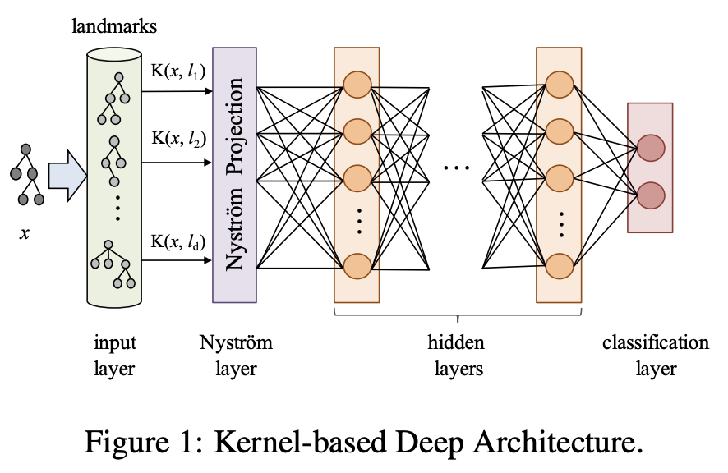
Explainability – Text Classification [Croce et al., 2019]
Layer-wise Relevance Propagation in Kernel-based Deep Architecture
Notes:
In this work by Croce et al., they used a specific post-hoc mechanism, which is to provide, along with the prediction, a comparison with one or more other training examples, what they call landmarks, that share task relevant linguistic properties with the input question. Briefly speaking, the main idea is that they want to identify which training example or which set of training examples are semantically and linguistically similar to the one we need to explain.
The way that they identify relevant examples is a method called layer-wise relevance propagation, which was first introduced in computer vision to identify the most relevant pixels in the input data that contributes the most to the final prediction.
We will discuss layer-wise relevance propagation later in this tutorial, for now, just think that it is an approach that can propagate the signal that are important to the final prediction from the ast layer of neural network to the input layer, in computer vision, the input layer corresponds to the pixels of and image.
The authors of this paper proposed that, with some careful design of the neural network, layer-wise relevance propagation can be used for explaining question classification, but instead of identify relevant pixels, in question classification, the goal is to identify relevant examples. The idea they had was to extend layer-wise relevance propagation to a kernel-based deep learning architecture.
In a high level, they use kernels to model the similarities between a test instance and the training examples. It follows that the network is triggered by an input vector x expressing the kernel evaluating the similarity between the example and the landmarks, or training examples.
When using linguistic kernels (such as Semantic Tree Kernels) this measure corresponds to the grammatical and lexical semantic similarity between x and the subset of landmarks. The expected explanation is obtained from the network output by applying layer-wise relevance propagation.
Again the technical details of this work can be found in their paper.

Slide 67
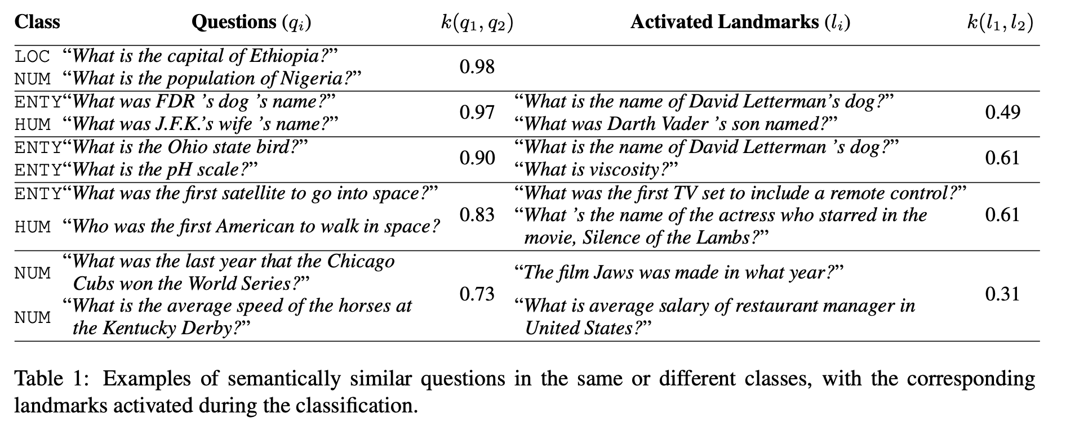
Explainability – Text Classification [Croce et al., 2019]
Need to understand the work
Thoroughly
Notes:
Here are some examples taken from their paper, which gives you some idea of the kind of explanation they are providing to the user. Some of the examples are quite intuitive. For example, when explaining why the question What was FDR’s dog’s name?” is referring to an entity, the activated examples that they show is a similar question asking “what’s the name of David Letterman’s dog”
Example-driven approach is quite intuitive because it uses training data as explanation, which is basically also labeled by humans. The only concern would be if there is completely out-of-blue question that we don’t have any similar examples in the training data, this method may fail to provide any meaningful explanation.

Slide 68
Explainability – Provenance-based
Definition
Explanations are provided by illustrating (some of) the prediction derivation process
An intuitive and effective explainability technique when the final prediction is the result of a series of reasoning steps.
Several question answering papers adopt this approach.
[Abujabal et al., 2017] – Quint system for KBQA (knowledge-base question answering)
[Zhou et al., 2018] – Multi-relation KBQA
[Amini et al., 2019] – MathQA, will be discussed in the declarative induction part (as a representative example of program generation)

Slide 69

Provenance-Based: Quint System
A. Abujabal et al. QUINT: Interpretable Question Answering over Knowledge Bases. EMNLP System Demonstration, 2017.
“Where was Martin Luther raised?”
When QUINT answers a question, it shows the complete derivation sequence:
how it understood the question:
Entity linking: entity mentions in text ⟼ actual KB entities
Relation linking: relations in text ⟼ KB predicates
the SPARQL query used to retrieve the answer:
“Eisleben”
Martin_Luther
Martin_Luther_King_Jr.
place_of_birth
desc
desc
Eisleben
“ … a German professor of theology, composer, priest, monk and …”
Learned from query templates based on structurally similar instances (“Where was Obama educated?”)
Derivation provides insights towards reformulating the question (in case of errors)

Slide 70
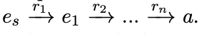
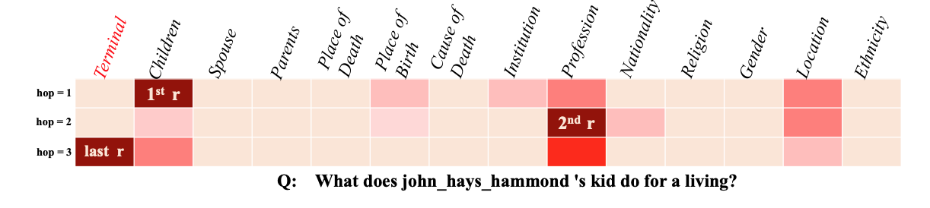
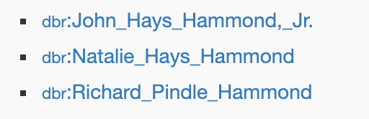



Provenance-Based: Multi-Relation Question Answering
IRN (Interpretable Reasoning Network):
Breaks down the KBQA problem into multi-hop reasoning steps.
Intermediate entities and relations are predicted in each step:
M. Zhou et al. An Interpretable Reasoning Network for Multi-Relation Question Answering. COLING, 2018.
Facilitates correction by human (e.g., disambiguation)
multiple answers in this example (3 different children)
Child
Profession
Reasoning path: John_Hays_Hammond ⟶ e ⟶ a
Notes:
Each row represents a probability distribution over relations

Slide 71
Explainability – Declarative Induction
Definition
The main idea of Declarative Induction is to construct human-readable representations such as trees, programs, and rules, which can provide local or global explanations.
Explanations are produced in a declarative specification language, as humans often would do.
Trees
[Jiang et al., ACL 2019] - express alternative ways of reasoning in multi-hop reading comprehension
Examples of local explainability (per instance)
(Specialized) Programs:
[A. Amini et al., NAACL, 2019] – MathQA, math programs for explaining math word problems
Rules:
[A. Ebaid et al., ICDE Demo, 2019] - Bayesian rule lists to explain entity matching decisions
[Pezeshkpour et al, NAACL 2019] - rules for interpretability of link prediction
[Sen et al, EMNLP 2020] - linguistic expressions as sentence classification model
[Qian et al, CIKM 2017] - rules as entity matching model
Examples of global explainability
(although rules can also be used for local explanations)
71

Slide 72
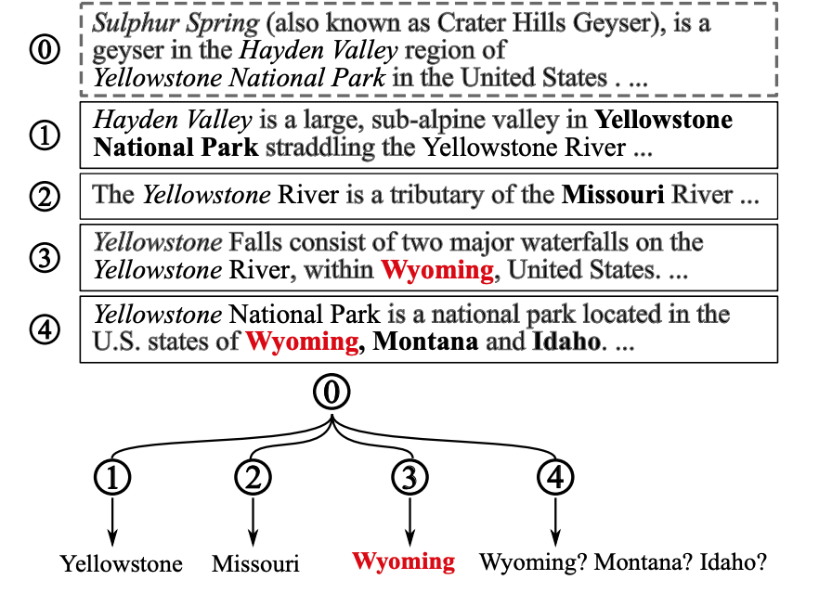
Declarative Induction: Reasoning Trees for Multi-Hop Reading Comprehension
Task: Explore and connect relevant information from multiple sentences/documents to answer a question.
Question subject: “Sulphur Spring”
Question body: located in administrative territorial entity
Reasoning trees play dual role:
Accumulate the information needed to produce the answer
Each root-to-leaf path represents a possible answer and its derivation
Final answer is aggregated across paths
Explain the answer via the tree
Y. Jiang et al. Explore, Propose, and Assemble: An Interpretable Model for Multi-Hop Reading Comprehension. ACL, 2019.

Slide 73
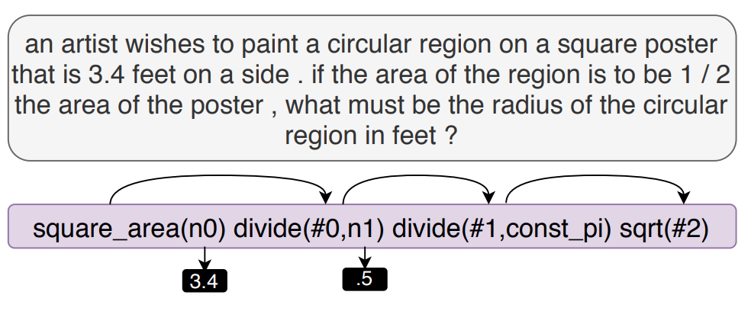
Declarative Induction: (Specialized) Program Generation
Task: Understanding and solving math word problems
A. Amini et al. MathQA: Towards Interpretable Math Word Problem Solving with Operation-Based Formalisms. NAACL-HLT, 2019.
Seq-2-Program translation produces a human-interpretable representation, for each math problem
Does not yet handle problems that need complicated or long chains of mathematical reasoning, or more powerful languages (logic, factorization, etc).
Also fits under provenance-based explainability:
provides answer, and how it was derived.
Domain-specific program based on math operations
Representative example of a system that provides:
Local (“input/output”) explainability
But no global explanations or insights into how the model operates (still “black-box”)

Slide 74
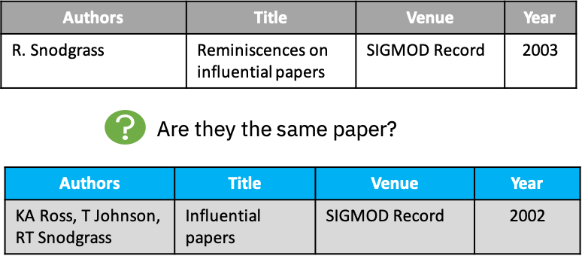
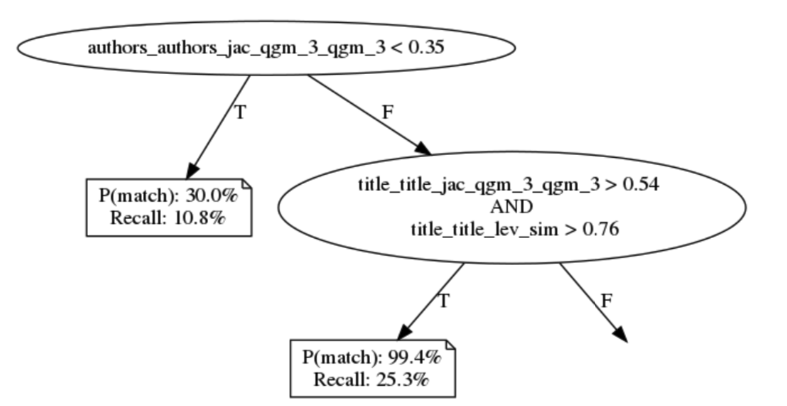
Declarative Induction: Post-Hoc Explanation for Entity Resolution
Entity resolution (aka ER, entity disambiguation, record linking or matching)
M. T. Ribeiro et al. Why should I trust you: Explaining predictions of any classifier. In SIGKDD, pp. 1135—1144, 2016.
Local explanations
(e.g., how different features contribute to a single match prediction – based on LIME)
Global explanations
Approximate the model with an interpretable representation
(Bayesian Rule List -- BRL)
Representative examples
Small, diverse set of <input, output> tuples to illustrate where the model is correct or wrong
Differential analysis
Compare with other ER model (disagreements, compare performance)
B. Letham et al. Interpretable classifiers using rules and Bayesian analysis. Annals of Applied Stat., 9(3), pp. 1350-1371, 2015.
Black-box model
ExplainER
Can also be seen as a tree
(of probabilistic IF-THEN rules)
A. Ebaid et al. ExplainER: Entity Resolution Explanations. ICDE Demo, 2019.

Slide 75
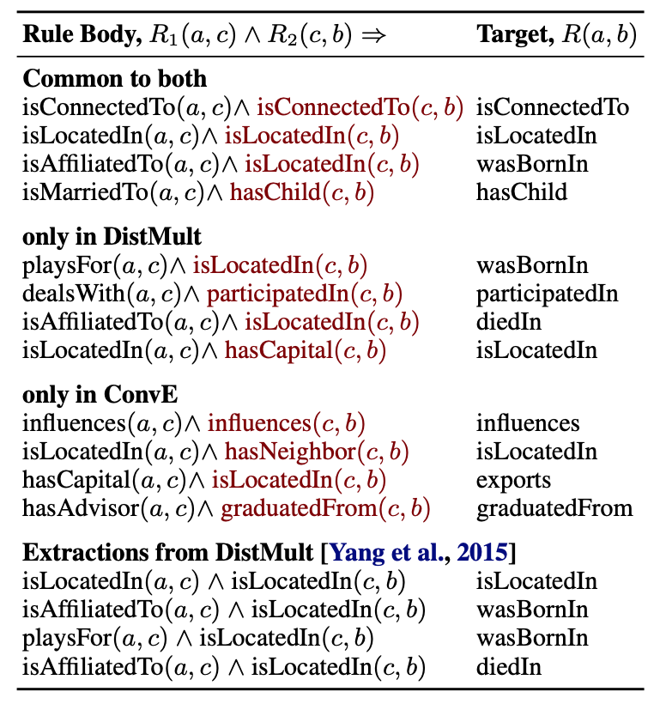
Declarative Induction: Rules for Link Prediction
Task: Link prediction in a knowledge graph, with focus on robustness and explainability
Uses adversarial modifications (e.g., removing facts):
Identify the KG nodes/facts most likely to influence a link
Aggregate the individual explanations into an extracted set of rules operating at the level of entire KG:
Each rule represents a frequent pattern for predicting the target link
Works on top of existing, black-box models for link prediction:
DistMult: B. Yang et al. Embedding entities and relations for learning and inference in knowledge bases. ICLR 2015
ConvE: T. Dettmers et al. Convolutional 2d knowledge graph embeddings. AAAI 2018
Global explainability able to pinpoint common mistakes in the underlying model (wrong inference in ConvE)
P. Pezeshkpour et al. Investigating Robustness and Interpretability of Link Prediction via Adversarial Modifications. NAACL 2019.
Notes:
Notes from the paper on the rule extraction part:
“Instead of focusing on individual predictions, we aggregate the explanations over the whole dataset for each relation using a simple rule extraction technique: we find simple patterns on subgraphs that surround the target triple and the removed fact from CRIAGE Remove and appear more than 90% of the time. We only focus on extracting length-2 horn rules, i.e., R1(a, c) ∧ R2(c, b) ⇒ R(a, b), where R(a, b) is the target and R2(c, b) is the removed fact.

Slide 76
Previous approach for rule induction:
The result is a set of logical rules (Horn rules of length 2) that are built on existing predicates from the KG (e.g., Yago).
Other approaches also learn logical rules, but they are based on different vocabularies:
Next:
Logical rules built on linguistic predicates for Sentence Classification
[SystemER – see later under Explainability-Aware Design]
Logical rules built on similarity features for Entity Resolution

Slide 77


Declarative Induction: Linguistic Rules for Sentence Classification
Task: Sentence classification in a domain (e.g., legal/contracts domain)
Notices will be transmitted electronically, by registered or certified mail, or courier
Label
“Communication”
“Terms and Termination”
…
…
Rules (predicates based on syntactic/semantic parsing)
Representative example of system that uses a neural model to learn another model (the rules)
The rules are used for classification but also act as global explanation
Joint learning of both rules and domain-specific dictionaries
Explainable rules generalize better and are more conducive for interaction with the expert
(see later – Visualization)
$∃$ verb $∈S:$
verb.theme $∈$ ThemeDict
and verb.voice = passive
and verb.tense = future
Syntactic and Semantic NLP Operators
Dictionaries
ThemeDict
communication notice
(Explainable) Deep Learning
Sen et al, Learning Explainable Linguistic Expressions with Neural Inductive Logic Programming for Sentence Classification. EMNLP 2020.

Slide 78
Common Operations to enable explainability
A few commonly used operations that enable different explainability
First-derivative saliency
Layer-wise relevance propagation
Input perturbations
Attention
LSTM gating signal
Explainability-aware architecture design
Notes:
We have discussed different explainability technqiues, a natural question is that, what are the operations we may use to enable these explainability?
We next briefly talk about a few commonly used operations that we observed from the paper we have reviewed
In particular, we observed six major kinds of operations. Including:
First-derivative saliency, layer-wise relevance propagation, input perturbations, attention, LSTM gating signal, and explainability-aware architecture design.

Slide 79




Operations – First-derivative saliency
Mainly used for enabling Feature Importance
[Li et al., 2016 NAACL], [Aubakirova and Bansal, 2016]
Inspired by the NN visualization method proposed for computer vision
Originally proposed in (Simonyan et al. 2014)
How much each input unit contributes to the final decision of the classifier.
Input embedding layer
Output of neural network
Gradients of the output wrt the input
Notes:
The first one we are going to talk about is an operation called first-derivative saliency. We observe that it is mainly used to enable feature importance.
First-derivative saliency was introduced as a neural network visualization approach proposed for computer vision problems. The basic idea is to compute the impact of each input unit, namely, each pixel, ot the final decision of the classifier.
Let’s think of a simple neural network as shown here, with E being the input layer, after going through multiple hidden layers, it finally makes a prediction S sub y of E.
Since the neural network basically forms a computation graph from the input to the output prediction, once we have the final prediction, usually is a vector of real values, we can compute the gradients of each node in this computation graph, all the way back to the input layer.
Intuitively, greater gradients indicate greater impact, therefore, we can use the gradients of the first layer as the saliency importance score, and that is why it is called first-derivative saliency.

Slide 80

Operations – First-derivative saliency
Naturally, it can be used to generate explanations presented by saliency-based visualization techniques
Sentiment Analysis
[Li et al., 2016 NAACL]
Notes:
Since first-derivative saliency are importance scores of the first input layer, we can naturally use saliency heatmap, as shown here, to visualize the importance of the input elements.
Here, we have a chart taken from the work done by Li et al., where they were using first-derivative saliency to show the importance of the input words to the final sentiment label using different neural network architectures.
From this chart, we can also see that, comparing to simple RNN and one-directional LSTM, BiLSTM provides more intuitive visualization clearly indicating that the word “hate” is the most influential word from the input sentence.

Slide 81

Operations – Layer-wise relevance propagation
For a good overview, refer to
An operation that is specific to neural networks
Input can be images, videos, or text
Main idea is very similar to first-derivative saliency
Decomposing the prediction of a deep neural network computed over a sample, down to relevance scores for the single input dimensions of the sample.
[Montavon et al., 2019]
[Montavon et al., 2019]
Notes:
The next operation is Layer-wise relevance propagation, which is quite similar to first-derivative saliency that we mentioned earlier. As we discussed in the explainability technique section, it was first proposed for explaining computer vision predictions by highlighting the most evident part of an image.
Recently, we have seen quite a few works that extend this idea to solve NLP problems. Similar to first derivative saliency, the idea is to measure the contribution of the input elements to the final prediction. In NLP, that usually leads to characters, tokens, and words.

Slide 82




Operations – Layer-wise relevance propagation
Key difference to first-derivative saliency:
Assigns to each dimension (or feature), $x_{d}$, a relevance score $R_{d}^{(1)}$ such that
Propagate the relevance scores using purposely designed local propagation rules
Basic Rule (LRP-0)
Epsilon Rule (LRP-$ϵ$)
Gamma Rule (LRP-$γ$)
[Croce et al]
$$f\left(x\right)≈\sum_{d}{R_{d}^{(1)}}$$
$R_{d}^{(1)}$ > 0 – the feature in favor the prediction
$R_{d}^{(1)}$ < 0 – the feature against the prediction
[Montavon et al., 2019]
Notes:
The main difference between first-derivative saliency and layer-wise relevance propagation is described by this formula.
Here, f of x corresponds to the prediction score or the final output score of a model. Layer-wise relevance propagation distribute this score and assign them to each dimension of the first input layer such that the relevance score of the input layer roughly sum up to the final score.
In particular, if the relevance score at a certain dimension is greater than 0, it means that this feature in favor the prediction, otherwise it against the prediction.
Unlike first-derivative saliency that uses gradients as a proxy of the relevance score, layer-wise relevance propagation uses local propagation rules to distribute and propagate the relevance scores from later layers to earlier layers in a neural net, making sure that the relevance score of the input layer can roughly sum up to the final score.
More mathematical justifications of these rules can be found in the work done by montavon et al..

Slide 83







Operations – Input perturbation
Usually used to enable local explanation for a particular instance
Often combined with surrogate models
A classifier
Usually not interpretable
Prediction made
by the classifier
An input instance
$$X$$
$$f$$
$$f(X)$$
$$X^{1}, X^{2}, …X^{m}$$
$${f(X}^{1}), {f(X}^{2}), …{f(X}^{m})$$
Perturbed instances
Prediction made by the original classifier
$$g$$
$$g(X)$$
Explanation to humans
A surrogate classifier
usually interpretable
Notes:
Next we talk about Input Perturbation. This is actually one of the most popular operations we have observed. It is usually used to enable local explanation for a particular instance. We saw a lot of surrogate model approaches adopted this operation.
Usually, it has a classifier f that is not explainable, and it made a prediction over a particular instance X, denoted by f of x. since f is not explainable, we don’t have any explanation for f of x.
Then, based on the input instance X, we use input perturbation to generate a set of m new instances, then use the unexplainable classifier f to make predictions over these perturbed examples.
After that, we learn a surrogate model, g, usually an explainable model from the set of labeled examples we obtained through input perturbation. The goal is that we would like to make sure that g well approximates the behavior of f by generating the same labels for the same input instances. Once we have g ready, we can use it to generate explanation for the input instance X.

Slide 84
Operations – Input perturbation
Different ways to generate perturbations
Sampling method (e.g., [Ribeiro et al. KDD] - LIME )
Perturbating intermediate vector representation (e.g., [Alvarez-Melis and Jaakkola, 2017])
Sampling method
Directly use examples within labeled data that are semantically similar
Perturbating intermediate vector representation
Specific to neural networks
Introduce minor perturbations to the vector representation of input instance
Notes:
We observed that there are in general two different ways to pertub examples, including sampling-based approach, and perturbating intermediate vector representation.
Sampling-based approach directly uses examples within labeled data to get the perturbations
and the second method is specific to neural networks, where it introduce minor perturbations to the vector representation of input instance
We next provide more details for each of the three methods

Slide 85
Input perturbation – Sampling method
[Ribeiro et al. KDD]
Find examples that are both semantically “close” and “far away”
from the instance in question.
Need to define a proximity metric
Will not generate instance
Notes:
The most representative work for sampling based approach is the LIME paper, which we have discussed previously. Just a quick reminder that, LIME is a sampling-based approach because it selects examples from the training data. It doesn’t generate new examples.

Slide 86
Perturbating intermediate Vector Representation
[Alvarez-Melis and Jaakkola, 2017])
Explain predictions of any black-box structured input – structured output model
Around a specific input-output pair
An explanation consists of groups of input-output tokens that are causally related.
The dependencies (input-output) are inferred by querying the blackbox model with perturbed inputs
Notes:
An alternative approach to add minor perturbations to input instances is by adding perturbation to intermediate vector representations.
Here, we talk about a work done by Alvarez-Melis and Jaakkola et al, where they proposed a method that explains predictions of any blackbox structured input - structured output model around a specific input-output pair. So it’s local explanation.
An explanation produced by their framework consists of groups of input-output tokens that are causally related.
The dependencies between input tokens and output tokens are inferred by querying the blackbox model with perturbed inputs.

Slide 87

Perturbating intermediate Vector Representation
[Alvarez-Melis and Jaakkola, 2017])
Notes:
This is a figure taken from their paper that illustrates their approach. The core idea is quite similar to LIME, basically when they have to explain an input output pair, they first obtain perturbed versions that are semantically similar to the original but with potential changes in elements and their order.
However, unlike getting perturbed examples for images which is simple. Getting perturbed version for sentences is much more challenging. In their work, they used a variational autoencoder, and their goal is to introduce the perturbation in the continuous latent representation rather than directly on the structured inputs.

Slide 88


Perturbating intermediate Vector Representation
[Alvarez-Melis and Jaakkola, 2017])
Typical autoencoder
Variation autoencoder
(generative model)
Image source: https://towardsdatascience.com/understanding-variational-autoencoders-vaes-f70510919f73
Notes:
Although it is out of the scope of the tutorial, we would like to briefly talk about how we can use variational autoencoder to generate variations.
The main difference between autoencoder and variational autoencoder is that, autoencoder use the bottleneck architecture to compress an input data point to a data point in a latent feature space
Whereas variational autoencoder defines a probability distribution in the latent space for input datapoints. Since we have a distribution in the latent space, we can sample different data points from this distribution to get perturbed version of the input data point. Again, this is a very high-level description and this topic is out of scope, interested reader can dive deeper into their paper to get more details.

Slide 89
Operations – Attention
Naturally, can be used to enable feature importance
[Ghaeini et al., 2018]
Attention mechanism uses the latent features learned by the encoder
a weighted combination of the latent features
Weights become the importance scores
of these latent features (also corresponds
to the lexical features) for the decoded
word/token.
Image courtesy: https://smerity.com/articles/2016/google_nmt_arch.html
[NEURAL MACHINE TRANSLATION BY JOINTLY LEARNING TO ALIGN AND TRANSLATE. Bahdanau et al., ICRL 2015]
Notes:
Next one is attention, which is of course one of the most popular deep learning mechanisms. Since we have talked about it before, we will not repeat it again, but just one comment here
We have seen a lot of attention-based operations that enables feature importance explainability in our literature review, suggesting that attention mechanism is a good starting point for enabling feature importance.

Slide 90

Operations – LSTM gating signals
LSTM gating signals determine the flow of information
How LSTM reads the word sequences and how the information from different parts is captured and combined
Gating signals are computed as the partial derivative of the score of the final decision wrt each gating signal.
[Ghaeini et al., 2018]
Image source: https://blog.goodaudience.com/basic-understanding-of-lstm-539f3b013f1e
Notes:
Next we have LSTM gating signals. Clearly, this is an operation that is specific to LSTM-based approach.
The intuition behind this method is that, we know LSTM is a classic neural network for sequence modeling. It process a sequence of input element at different timestamp, and each LSTM cell has different gates including input gate, output gate, and forget gate. These LSTM gating singals can determine the flow of information, that is, how LSTM reads the word sequences and how the information from different parts is captured and combined.
Once the whole sequence has been processed, we can then look into the gating signals, which are computed as the partial derivatives of the score of the final decision with respect to each gating signal.

Slide 91

Operations – LSTM gating signals
Notes:
In the work done by Ghaeni etal ,
when computing the gating signals, instead of considering individual dimensions of the gating signals, they aggregate them to consider their norm, both for the signal and for its saliency. After that is done, they visualize the normalized signal of each gate at different timestamps, as shown here.
The score is a way to indicate the importance of the element to the final decision.
Unfortunately, there was no enough details about the formula they used to compute the norm, and it seems that they probably first standardized the signals so that when computing the norms the values are within the range 0 to 1

Slide 92

Explainability-Aware: Rule Induction Architecture
P. Pezeshkpour et al. Investigating Robustness and Interpretability of Link Prediction via Adversarial Modifications. NAACL 2019.
Works on top of existing, black-box models for link prediction, via a decoder architecture (i.e., from embeddings back to graph)
Knowledge graph facts:
wasBornIn (s, o)
Decode back the vector z_{s’r’} to actual KG:
isLocatedIn (s’, o)
Rules of length 2 are then extracted by identifying frequent patterns
Optimization problem in R^{d}: find the most influential vector z_{s’r’} whose removal would lead to removal of wasBornIn (s, o)
isAffiliatedTo (a, c) ∧ isLocatedIn (c, b) → wasBornIn (a,b)
Notes:
Notes from the paper on the rule extraction part:
“Instead of focusing on individual predictions, we aggregate the explanations over the whole dataset for each relation using a simple rule extraction technique: we find simple patterns on subgraphs that surround the target triple and the removed fact from CRIAGE Remove and appear more than 90% of the time. We only focus on extracting length-2 horn rules, i.e., R1(a, c) ∧ R2(c, b) ⇒ R(a, b), where R(a, b) is the target and R2(c, b) is the removed fact.

Slide 93




Explainability-Aware Design: Rule-Based Active Learning
Qian et al, SystemER: A human-in-the-loop System for Explainable Entity Resolution. VLDB’17 Demo (also full paper in CIKM’17)
Iteratively learns an ER model via active learning from few labels.
Rules: explainable representation for intermediate states and final model
Rules: used as mechanism to generate and explain the examples brought back for labeling
Large datasets to match
corporation | Zip | City | address
Trader Joe’s | 95118 | San Jose | 5353 Almaden Express Way
company | Zip | City | address
Trader Joe’s | 95110 | San Jose | 635 Coleman Ave
Candidate rule learning
R.corporation = S.company
and R.city = S.city
Rule Learning
Algorithm
refinement
R.corporation = S.company
and R.city = S.city
and R.zip = S.zip
Example selection
corporation | Zip | City | address
KFC | 90036 | LA | 5925 W 3rd St.
company | Zip | City | address
KFC | 90004 | LA | 340 N Western Ave
Not a match
Domain expert labeling

Slide 94
SystemER: Example Selection (Likely False Positives)
Candidate rule R1
To refine R1 so that it becomes high-precision,
need to find examples from the matches of R1
that are likely to be false positives
Negative examples will enhance precision
U: D₁ x D₂
+
+
+
-
-
-
+ +
-
-
+
+ +
+
+
+
+
+
Matches (R1)
+
+
+
+
+
+
+
+

Slide 95
SystemER: Example Selection (Likely False Negatives)
Candidate rule R1
To refine R1 so that it becomes high-precision,
need to find examples from the matches of R1
that are likely to be false positives
Negative examples will enhance precision
Rule-Minus heuristic: explore beyond the current R1 to find what it misses (likely false negatives)
U: D₁ x D₂
+
+
+
+
-
-
-
i.firstName = t.first
AND i.city = t.city
AND i.lastName = t.last
+ +
-
-
Rule-Minus3
R1:
+
+ +
+
+
+
+
+
Matches (R1)
+
+
+
+
Rule-Minus1
+
+
Rule-Minus1
Rule-Minus2
+
i.firstName = t.first
AND i.city = t.city
AND i.lastName = t.last
i.firstName = t.first
AND i.city = t.city
AND i.lastName = t.last
+
Rule-Minus2
+
+
+
+
Rule-Minus3
i.firstName = t.first
AND i.city = t.city
AND i.lastName = t.last
New positive examples will enhance recall
At each step, examples are explained/visualized based on the predicates they satisfy or not satisfy

Slide 96
Part II – (b) Visualization Techniques

Slide 97
What’s next
Mathematical
justifications
Visualizing
justifications
XAI model
End user
1. Explanation
Generation
2. Explanation
Presentation
AI engineers
UX engineers
Visualization Techniques
Notes:
We now move to the second part, that is, the techniques used for visually presenting raw explanations to end users.

Slide 98
Visualization Techniques
Presenting raw explanations (mathematical justifications) to target user
Ideally, done by UX/UI engineers
Main visualization techniques:
Saliency
Raw declarative representations
Natural language explanation
Raw examples
Notes:
The main goal of visualization is to present the generated raw explanation in an appropriate way to end users.
Unlike explainability techniques, which are better handled by AI engineers. Visualization is better done by UX and UI engineers who know users better.
From our literature review, we have identified a few representative visualization techniques including saliency, raw declarative representations, natural language explanation, and raw examples.
We will talk about them next.

Slide 99
Visualization – Saliency
Definition
has been primarily used to visualize the importance scores of different types of elements in XAI learning systems
One of the most widely used visualization techniques
Not just in NLP, but also highly used in computer vision
Saliency is popular because it presents visually perceptive explanations
Can be easily understood by different types of users
A computer vision example
Notes:
Based on our literature review, saliency is the most popular visualization technique. In fact, it is probably the most widely used visualization technique in all AI domain.
By definition, saliency is used to visualize the importance scores of different types of elements in XAI learning systems. Saliency is very popular because it presents visually perceptive explanations, that can be easily understood by different types of users.
Here, we show an example of using saliency to highlight the most important parts of an image for a computer vision task. Clearly, for computer vision tasks, saliency-based visualization is self-explaining and human-comprehensible

Slide 100

Visualization – Saliency Example
[Bahdanau et al., 2015]
Input-output alignment
Notes:
Here are two other examples of saliency-based visualizations. Both of the charts are visualizations for machine translation tasks. Saliency is used here to visualize the input-output alignment. In particular, the intensity of the color of the cells indicate the input-output relevance score, that is, the saliency scores. It can be seen that saliency heatmaps shown here can be understood by humans.

Slide 101




Visualization – Saliency Example
[Schwarzenberg et al., 2019]
[Wallace et al., 2018]
[Garneau et al., 2018]
[Harbecke et al, 2018]
Notes:
We have more examples of the usage of saliency-based visualization. Here are four examples that are not input-output alignment. T
he commonality among these examples is that they use saliency highlighting to indicate the importance of tokens or words for the final decision that they made for their NLP problems.
As we can see from the charts, saliency-based visualization is quite flexible in the sense that, you may use different color with different intensities to indicate the impact of words. For example, the chart at the top right corner uses two different highlighting colors, where blue indicates positive impact while pink indicates negative impact. We also see that, for positive impact, we can further use different intensities to indicate the significances of different positively impact words, and this kind of subtly can be easily captured by humans,

Slide 102


Visualization – Declarative Representations
Trees:
[Jiang et al., ACL 2019]
Different paths in the tree explain the possible reasoning paths that lead to the answer
Rules:
[Pezeshkpour et al, NAACL 2019]
Logic rules to explain link prediction
(e.g., isConnected is often predicted because of transitivity rule, while hasChild is often predicted because of spouse rule)
[Sen et al, EMNLP 2020]
Linguistic rules for sentence classification:
More than just visualization/explanation
Advanced HCI system for human-machine co-creation of the final model, built on top of rules
(Next)
isConnected(a,c) ∧ isConnected (c,b) ⟹ isConnected(a,b)
isMarriedTo (a,c) ∧ hasChild (c,b) ⟹ hasChild(a,b)
Human feedback
$∃$ verb $∈S:$
verb.theme $∈$ ThemeDict
and verb.voice = passive
and verb.tense = future
Machine-generated rules

Slide 103

Linguistic Rules: Visualization and Customization by the Expert
Sentence classification rules learned by [Sen et al, Learning Explainable Linguistic Expressions with Neural Inductive Logic Programming for Sentence Classification. EMNLP 2020]
Label being assigned
Theme-MatchesDictionary-NonAgentSectionTitleClues
Various ways of selecting/ranking rules
Manner-MatchesDictionary-MannerContextClues
Passive-Voice
Manner-MatchesDictionary-MannerContextClues
VerbBase-MatchesDictionary-SectionTitleClues
Possibility-ModalClass
Theme-MatchesDictionary-NonAgentSectionTitleClues
Rule-specific performance metrics
VerbBase-MatchesDictionary-SectionTitleClues
NounPhrase-MatchesDictionary-SectionTitleClues
VerbBase-MatchesDictionary-SectionTitleClues
NounPhrase-MatchesDictionary-SectionTitleClues
Passive-Voice
Y. Yang, E. Kandogan, Y. Li, W. S. Lasecki, P. Sen. HEIDL: Learning Linguistic Expressions with Deep Learning and Human-in-the-Loop. ACL, System Demonstration, 2019.

Slide 104

Linguistic Rules: Visualization and Customization by the Expert
Negative-Polarity
Possibility-ModalClass
Passive-Voice
Visualization of examples per rule
VerbBase-MatchesDictionary-SectionTitleClues
Present-Tense
Imperative-Mood
Manner-MatchesDictionary-MannerContextClues
Manner-MatchesDictionary-MannerContextClues
VerbBase-MatchesDictionary-VerbBases
Imperative-Mood
VerbBase-MatchesDictionary-VerbBases
Y. Yang, E. Kandogan, Y. Li, W. S. Lasecki, P. Sen. HEIDL: Learning Linguistic Expressions with Deep Learning and Human-in-the-Loop. ACL, System Demonstration, 2019.

Slide 105

Linguistic Rules: Visualization and Customization by the Expert
NounPhrase-MatchesDictionary-SectionTitleClues
Passive-Voice
Playground mode allows to add/drop predicates
Future-Tense
NounPhrase-MatchesDictionary-SectionTitleClues
Passive-Voice
Future-Tense
Human-machine co-created models generalize better to unseen data
humans instill their expertise by extrapolating from what has been learned by automated algorithms
Y. Yang, E. Kandogan, Y. Li, W. S. Lasecki, P. Sen. HEIDL: Learning Linguistic Expressions with Deep Learning and Human-in-the-Loop. ACL, System Demonstration, 2019.

Slide 106

Visualization – Raw Examples
Definition
Explaining by presenting one (or some) instance(s) (usually from the training data) that is semantically similar to the instance needs to be explained
Use existing knowledge to explain a new instance
Jaguar is a large spotted predator of tropical
America similar to the leopard.
Raw examples
Word sense disambiguation
[Panchenko et al., 2016]
Notes:
Presenting raw examples is another widely used visualization technique to deliver explanations. Suggested by its name, this approach explains a decision made by an AI model by presenting one or some examples, either from the existing training data or generate some new ones, that are semantically similar to the instance needs to be explained.
Here is an example that we took from the work done by Panchenko et al. The NLP task they studied was word sense disambiguation.
In this particular example, we need to explain the word sense of Jaguar in the sentence “Jaguar is a large spotted predator of tropical America similar to the leopard”. This work provides multiple explanations, and one of them is example-driven based approach, where they identified two examples that are similar to the one in question. For example, one of the raw example presented is the sentence: “The jaguar, a compact and well-muscled animal, is the largest cat in the new world.

Slide 107



Visualization – Raw Examples
Sentences taken from the labeled data
Explain with one instance (basic model)
Explain with > 1 instance (multiplicative model)
Classification
[Croce et al, 2018]
Explain with both positive and negative instance
(contrastive model)
Notes:
Here is another example. Again, the way this approach used to explain the theme of a phrase in a sentence is by presenting one or more examples, which can either be a positive example or a negative example, or both.

Slide 108
Visualization – Natural language explanation
Definition
The explanation is verbalized in human-comprehensible language
Can be generated by using sophisticated deep learning approaches
[Rajani et al., 2019]
Can be generated by simple template-based approaches
[Abujabal et al,, 2017 - QUINT]
[Croce et al, 2018]
Many declarative representations can be naturally extended to natural language explanation
Notes:
The next visualization technique is natural language explanation, which by its name means that explanations are verbalized in human-comprehensible language. We found a few work that adopted this visualization technique, and they can be categorized into two main types: the first type is using deep generative approaches generate natural language explanations and the second type is using template-based approaches.

Slide 109


Visualization – Natural language explanation
[Rajani et al., 2019]
A language model trained with human generated
explanations for commonsense reasoning
Open-ended human explanations
Explanation generated by CAGE
Notes:
The first example we show here is the one done by Rajani et al, where they try to explain common sense question answering problems. For example, the question could be ”They were getting ready for a really long hike, he put the food in his what?”. Along with this question, there are a few possible answers including recycling center, house, and backpack. The QA system may predict that the answer is backpack, and now we need to explain why the system came up with this answer.
The proposed method trains a deep generative model to produce the explanation. Concretely, they first ask human annotators to provide natural language explanations for common sense question answers from a dataset with ground truth, so they have the gold answers, what they want from the human is the explanation to the answers. In this way, they can get a training dataset, from which they can train a language model from the questions with answers and explanations. Once this model is trained, it can be used to generate explanations for future unseen data.
From the example shown here, we can see that, for the question we discussed earlier, the human annotator provided an explanation that `Backpacks are used on hikes`, while their model generate an explanation that is not similar to the human annotations, but also quite intuitive, it figures out that `a backpack is a place to store food and supplies’.

Slide 110
Visualization – Natural language explanation
Sentences taken from the labeled data
Explain with one instance (basic model)
Explain with > 1 instance (multiplicative model)
Classification
[Croce et al, 2018]
Explain with both positive and negative instance
(contrastive model)
Notes:
The next example we are going to talk was actually appeared earlier in raw-example visualization techniques. We think this also fall into the natural language explanation category. Note that the raw examples are the sentences with underlines. Clearly, there are some transition phrases that connect the raw examples.

Slide 111

Visualization – Natural language explanation
Template-based explanatory model
Classification
[Croce et al, 2018]
Notes:
So the authors of this work made a minor extension to the raw-example based approach, where they used a simple template-based approach to turn raw-examples into natural language explanation. Although it is very simple, it actually make the explanation more user friendly.
Same idea can be applied to some of the declarative representation methods, where we can, for example, turn first order logic rules into natural language using some predefined templates. Again, this is a minor extension, but it is more user friendly because not everyone is conformable with reading first-order logic rules.

Slide 112
Outline of Part II
Literature review methodology
Categorization of different types of explanation
Local vs. Global
Self-explaining vs. Post-hoc processing
Generating and presenting explanations
Explainability techniques
Common operations to enable explainability
Visualization techniques
Other insights (XNLP website)
Relationships among explainability and visualization techniques
Evolution of the XAI research in the past a few years
Evaluation of Explanations
Notes:
Now we have talked about different techniques for explanation generation and presentation. We next take a step back from the low-level technical details and look at the big picture.

Slide 113
XNLP
We built an interactive website for exploring the domain
It’s self-contained
It provides different ways for exploring the domain
Cluster View (group papers based on explainability and visualization)
Tree view (categorize papers in a tree like structure)
Citation graphs (show the evolution of the field and also show influential works)
List view (list the set of papers in a table)
Search view (support keyword search and facet search)
Link to the website: https://xainlp2020.github.io/xainlp/home
Notes:
First, we would like let you know that we have built an interactive website which can be viewed as a living survey or tutorial of XAI research for NLP.
Many of the insights we are going to discuss next were directly taken from the website. It has multiple interactive views that provide different ways for the user to explore this field.
The link to the website is provided here, and we encourage interested readers to visit the website to explore the field in their own ways.

Slide 114

XNLP - Tree View
https://xainlp2020.github.io/xainlp/clickabletree
Local post-hoc (11)
Local self-explaining (35)
Global self-explaining (3)
Global self-explaining (3)
Notes:
Here is a screenshot of the tree view from our XNLP website, which shows the distributions of the papers we included in our literature review.
Recall that when we introduced the four major categorizations, we mentioned that we can actually have a preference ranking for these four categories, that is, general global explanation is better than local explanation because global explanation implies local explanation. Self-explaining is also better than post-hoc, because there might be some fidelity issue of post-hoc approaches.
Therefore, we would expect there have been more effort on global post-hoc and global self-explaining. However, from this screenshot, we can see that global explanation approaches are far less popular than local explanation. In our view, it conveys the message that, achieving global explanation is more difficult than local explanation, which in turn indicates that, studying techniques that allow us to enable global explanation is one of the major future research direction for this field.

Slide 115


XNLP – List View
https://xainlp2020.github.io/xainlp/table
Notes:
Same observation can also be identified in List View of our website, also, in this view, users can further sort the papers in each category by their explainability techniques, visualization technique, venue, and NLP tasks.

Slide 116

XNLP – Cluster View
https://xainlp2020.github.io/xainlp/viz
Notes:
Our website also provides a cluster view page, where the readers can use this interactive chart to identify the distributions of different combinations of visualization techniques and explainability techniques.
From this screenshot, we can clearly see that about 30 papers, which is about 60%, of the papers that we included used the combination of feature importance and saliency as their explainability and visualization techniques.
Also, we can see that, all global self-explaining methods, that are all the black dots in this chart, used the combination of declarative representation induction and raw declarative representation as their explainability and visualization techniques, which partly explains why there are so few global self-explaining methods, because most of the papers we included are using deep learning based approaches, and derive declarative representations from deep neural network is extremely difficult, and this is also one of the hot topic in AI right now.

Slide 117

XNLP – Citation Graph
https://xainlp2020.github.io/xainlp/network
Notes:
Citation Graph view is another webpage we included in our XNLP website. It shows the evolution of citation networks in the past a few years. Note that we only visualized citations among the 52 papers that we included in this tutorial. This short animation can clearly show the evolution of the field, and also help us identify some of the most influential work in this field.

Slide 118

XNLP – Citation Graph
https://xainlp2020.github.io/xainlp/network
Notes:
For example, The paper that introduces LIME, is obviously the most influential work in the past a few years, it got a lot of citations from papers that are both focused on local explanation as well as local explanation.

Slide 119


XNLP – Search View
https://xainlp2020.github.io/xainlp/search
Notes:
The last view we want to mention is the search view of our website, as the screenshots show, the search view provides readers the flexibility to perform advanced searchings. The user can either use facet search to do more structured searching, or use keyword search to search against the metadata of each paper.

Slide 120
XNLP
More advanced ways to explore the field can be found in our website
https://xainlp2020.github.io/xainlp
Notes:
The static screenshots we show here and previous pages don’t show all the features of the website, for example, in each view, every paper is clickable, which will show a dialog of this paper containing different useful information such as representative screenshots from the paper, link to the paper, and etc.
In interest of time, we won’t showcase all the different ways that the user can explore with the field using our website, but we do encourage interested readers to explore our website to find out other advanced ways to explore the field.

Slide 121
Outline of Part II
Literature review methodology
Categorization of different types of explanation
Local vs. Global
Self-explaining vs. Post-hoc processing
Generating and presenting explanations
Explainability techniques
Common operations to enable explainability
Visualization techniques
Other insights (XNLP website)
Relationships among explainability and visualization techniques
Evolution of the XAI research in the past a few years
Evaluation of Explanations
Notes:
Before we close the second part of the tutorial, we would like to talk about how to evaluate the quality of generated explanation.

Slide 122

How to evaluate the generated explanations
An important aspect of XAI for NLP.
No just evaluating the accuracy of the predictions
Unsurprisingly, little agreement on how explanations should be evaluated
32 out of 52 lack formal evaluations
Only a couple of evaluation metrics observed
Human ground truth data
Human evaluation
Notes:
In addition to traditional performance evaluation for AI problems such as accuracy, precision, and recall. An important evaluation we need for XAI approaches is the evaluation of the effectiveness of generated explanation.
Given the young age of this field, it is not surprising that, there is little agreement on how explanations should be evaluated.
From the 52 papers we reviewed, 32 of them didn’t have any evaluation or used very informal evaluation, for example, they only have very high-level discussion of how examples of generated explanations align with human intuition. Some of them even use F1 score as a proxy to show the effectiveness of their explanations.
Very few of these paper adopted some forms of formal evaluation, which can basically be grouped into two categories, evaluating with human ground truth data and human evaluation.

Slide 123
Evaluation – Comparison to ground truth
Idea: compare generated explanations to ground truth explanations
Metrics used
Precision/Recall/F1 (Carton et al.,2018)
BLEU (Ling et al., 2017; Rajani et al., 2019b)
Benefit
A quantitative way to measure explainability
Pitfalls
Quality of the ground truth data
Alternative valid explanations may exit
Some attempts to avoid these issues
Having multiple annotators (with inter-annotator agreement)
Evaluating at different granularities (e.g., token-wise vs. phrase-wise)
Notes:
Several works compare generated explanations to ground truth data in order to quantify the performance of explainability techniques.
Employed metrics vary based on task and explainability technique, but commonly encountered metrics include P/R/F1 and BLEU While having a quantitative way to measure explainability is a promising direction, care should be taken during ground truth acquisition to ensure its quality and account for cases where there may be alternative valid explanations.
Approaches employed to address this issue involve having multiple annotators and reporting inter-annotator agreement or mean human performance, as well as evaluating the explanations at different granularities (e.g., token-wise vs phrase-wise) to account for disagreements on the precise value of the ground truth

Slide 124
Evaluation – Human Evaluation
Idea: ask humans to evaluate the effectiveness of the generated explanations.
Benefit
Avoiding the assumption that there is only one good explanation that could serve as ground truth
Important aspects
It is important to have multiple annotators (with inter-annotator agreement, avoid subjectivity)
Observations from our literature review
Single-human evaluation (Mullenbach et al., 2018)
Multiple-human evaluation (Sydorova et al., 2019)
Rating the explanations of a single approach (Dong et al., 2019)
Comparing explanations of multiple techniques (Sydorova et al., 2019)
Very few well-established human evaluation strategies.
Notes:
A more direct way to assess the explanation quality is to ask humans to evaluate the effectiveness of the generated explanations.
This approach has the advantage of avoiding the assumption that there is only one good explanation that could serve as ground truth, as well as sidestepping the need to measure similarity of explanations. Here as well, it is important to have multiple annotators, report inter-annotator agreement, and correctly deal with subjectivity and variance in the responses. The approaches found in this survey vary in several dimensions, including the number of humans in-volved (ranging from 1 to 25 humans), as well as the
high-level task that they were asked to perform (including rating the explanations of a single approach and comparing explanations of multiple techniques.
Generally speaking, human evaluation is a promising metric but very few used well-established human evaluation method, and this is a clear gap in this field, and needs to be addressed in the future.

Slide 125

Human Evaluation – Trust Evaluation (Sydorova et al., 2019)
Borrowed the trust evaluation idea used in CV (Selvaraju et al. 2016)
A comparison approach
given two models, find out which one produces more intuitive explanations
Model A
Explanation 1
Explanation 2
Blind evaluation
Examples that the two
models predict the same
labels
examples
Model B
Notes:
Although there were very few well-established human evaluation strategies, we indeed did notice one human evaluation method that worth mentioning.
It is called the trust evaluation method used in the work done by Sydorova et al. They borrowed the idea originally proposed by Selvaraju et al., in 2016 for evaluating their computer vision model.
the main idea of which is the following: Given two models with different performances, instances are chosen that are classified correctly by both models. Human annotators are presented the predicted instances of together with explanations generated by the two approaches, and the humans need to rate the reliability of the explanations without knowing which explanation is produced by which approach. The main point is that, since it considers only instances that the two approaches agree on, the reliability score is purely determined by the explanation. Effective explanations should help humans identify the better approach.

Slide 126

Human Evaluation – Trust Evaluation (Sydorova et al., 2019)
Notes:
Here is a screenshot of the interface they used for human evaluation. As you see, the interface shows the explanations generated by two different models, but which model produced which explanation is not shown to the user. And the explanations of a particular model may appear in the left or right of the user feedback interface randomly, so that the user can rate the explanation based on solely their effectiveness without being affected the provenance info of the explanation .
Trust evaluation has been widely adopted in computer vision domain, but rarely used in NLP domain. We think this is a good example of using a well-established evaluation metric. One of the nice properties is that it’s a model agnostic approach, indicating that it can be applied to different NLP tasks.
However, we have seen very few such strategies from our literature review, which is also one of the major gaps we have identified for our research community to address in the future.

Slide 127
Quality of Explanation – Predictive Process Coverage
The predictive process starts from input to final prediction
Not all XAI approaches cover the whole process
Ideally, the explanation covers the whole process or most of the process
However, many of the approaches cover only a small part of the process
The end user has to fill up the gaps
Notes:
Another important and often overlooked aspect for evaluating the quality of explanation is that, which part of the prediction process, starting with the input and ending with the model output, is covered by an explanation.
We have observed that many explainability approaches explain only part of this process, leaving it up to the end user to fill in the gaps.

Slide 128

Quality of Explanation – Predictive Process Coverage
Take MathQA (Amini et al. 2019) as an example
Induced mathematical
operations
Notes:
Take MathQA as an example
MathQA tries to solve the problem that given a math question expressed in natural language, derive the sequence of mathematical operations to get the final answer.
For example, if the math problem expression is: How long does a trian 110 meters long running at the speed of 72 killmeters per hour takes to cross a bridge 132 meters length?
Amni et al. designed a model using declarative induction explainability to derive a sequence of mathematical operations or programs such as
add 110 and 132
Multiply 72 by a constant 0.2778
Then divide the first number by the second number, then use floor operation to an integer number.
At the first glance, the generated explanation can be understood very well by the user.

Slide 129

Quality of Explanation – Predictive Process Coverage
Take MathQA (Amini et al. 2019) as an example
Notes:
However, if we look deeper at their method. The way that they generate the sequence of mathematical operations is by using a classic encoder-decoder model, which involves a deep neural network with a lot of layers between the input words and output mathematical operations.
This chart illustrates the architecture of their model, as we can see that they actually have an attention layer between encoder and decoder, which enabled feature importance explainability but they author chose not to use saliency heatmap to show the input-output alignment.
We are not trying to say that saliency heatmaps are much better, because they cannot give very detailed information about the reasoning logic behind the decoding part, but without it may cause some confusion in the MathQA case. When we discuss this paper during our literature review, many researchers found it very mysterious how the model came up with the mathematical operations, it was a black box to the user.
On the other hand, if the author provides the saliency heatmaps that visualize the input-output alignment along with the derived mathematical operations, it will give some insights on how each individual mathematical operation was derived from the original question expression.
Therefore, we think this is a good example to discuss in this tutorial, that the generated explanation may not capture the whole predictive process, and sometimes it was caused by using a black box model to get the final predictions, and sometimes it was caused by missing an important explainable part of the model, such as the MathQA model we show here, which has an attention layer but the authors chose to not use it as part of their explanation.

Slide 130
Fidelity
Often an issue arises in surrogate model
Surrogate model is flexible since its model-agnostic
Local fidelity vs. global fidelity
Logic fidelity
Surrogate model may use completely different reasoning mechanism
Is it really wise to use a linear model to explain a deep learning model?
Notes:
Fidelity is another important aspect when we design an XAI approach. Fidelity is usually an issue arises in surrogate mode- based approaches.
We all know that surrogate model is flexible since its model-agnostic. Prior surrogate model-based approach such as LIME focuses on the local fidelity and global fidelity issue.
There is another important aspect, which is logic fidelity issue. As we said earlier, surrogate model based approach is very flexible, but the flexibility comes at a price, that is, the proxy model may have completely different mechanism for making predictions, for example, you can use a linear model to explain a deep learning model as long as the linear model is locally faithful to the deep learning model. However, we may ask the question is it really wise to use a linear model to explain a deep learning model, can you really trust the explanation generated by a much simpler model?
This kind of questions are very important, especially when applying so-called XAI approaches in real-world scenarios, and have been less studied in the past.

Slide 131
PART III – Explainability & Case Study

Slide 132
Explainability
Human-Centered Problem
Notes:
As the explainability literature points, a very few percentage of papers had some form of human evaluation of the explanations that AI models generate.
As contemporary AI products’ become sophisticated, so do their complexities. People with different backgrounds and expertise might be interacting with the model. Simultaneously, the growing realization of the substantial roles they play as arbiters of human lives brings explainability in to center stage.
The design space for Explainable AI therefore, is an inherently human-centered.

Slide 133
Human-centered perspective on XAI
Human-AI interaction guidelines (Amershi et al., 2019)
Explanations in social sciences (Miller, 2019)
Leveraging human reasoning processes to craft explanations (Wang et al., 2019)
Explainability scenarios (Wolf, 2019)
Broader ecosystem of actors (Liao et al., 2020)
Explanations for human-AI collaboration during onboarding (Cai et al, 2019)
Amershi, S., Weld, D., Vorvoreanu, M., Fourney, A., Nushi, B., Collisson, P., ... & Teevan, J. (2019, May). Guidelines for human-AI interaction. In Proceedings of the 2019 CHI Conference on Human Factors in Computing Systems (pp. 1-13).
Miller, T. (2019). Explanation in artificial intelligence: Insights from the social sciences. Artificial Intelligence, 267, 1-38.
Wang, D., Yang, Q., Abdul, A., & Lim, B. Y. (2019, May). Designing theory-driven user-centric explainable AI. In Proceedings of the 2019 CHI conference on human factors in computing systems (pp. 1-15).
Wolf, C. T. (2019, March). Explainability scenarios: towards scenario-based XAI design. In Proceedings of the 24th International Conference on Intelligent User Interfaces (pp. 252-257).
Liao, Q. V., Gruen, D., & Miller, S. (2020, April). Questioning the AI: Informing Design Practices for Explainable AI User Experiences. In Proceedings of the 2020 CHI Conference on Human Factors in Computing Systems (pp. 1-15).
Cai, C. J., Winter, S., Steiner, D., Wilcox, L., & Terry, M. (2019). " Hello AI": Uncovering the Onboarding Needs of Medical Practitioners for Human-AI Collaborative Decision-Making. Proceedings of the ACM on Human-computer Interaction, 3(CSCW), 1-24.
Notes:
The Human Computer Interaction research area is burgeoning with research on AI explainability, especially one that brings a sharp focus onto the user or human perspective..
Scholars have synthesized guidelines for human-AI interaction that touch upon some aspects of explainability like making clear what the system can do, how well it can do, why it did what it did.
Explanation has long been studied in different fields such as cognitive psychology, communication and even more broadly in the social sciences. Millers work summarizes some of the facets of human explanations. First, explanations are contrastive(to a counterfactual case), explanations are selected, and they are socially constructed.
Researchers Wang and colleagues have argued that the design of explainable AI can find inspiration in human reasoning to appropriately map explainaibility techniques with cognitive patterns. Such an intentional mapping can drive synthesis between AI and humans.
The work of Wolf acknowledges the need to bridge the gap between AI algorithms and their explanations by examining actual settings of end use.
Recent work also points to the need for applying a wider aperture in understanding AI explainability, one that considers the broader ecosystem of actors, who hold stake in an AI system and who are keen to understand how it works and what effect it will have.

Slide 134
Human-Centered Approach to Explainabilty
Human-Centered approach to Explainabilty
User Study + Case Study

Slide 135
Explainability in Practice
RQ1: What is the nature of explainability concerns in industrial AI projects?
RQ2: Over the course of a model’s pipeline, when do explanation needs arise?

Slide 136

Interview Participants
AI Engineers -7
Data Scientists - 13
Designers – 2
Information Vis Specialists - 3
Product Managers - 3
Technical Strategists - 5
*some individuals were overlapping in two roles
Domains
Drug safety, key opinion leader mining, information extraction from business communications e.g., emails, contract document understanding, HR, chatbots, public health monitoring ….
Notes:
1) To capture a variety of experiences and perspectives across text analytics projects, we conducted an interview study where recruited broadly and required each informant to have worked on a text project in some capacity and to have explained to another person how AI applications for text work (these explanations could have been delivered internally to project team members externally to clients).
2) Accordingly, our informants represent a range of roles across a variety of industrial AI projects, including, technical development roles (Data Scientists and AI engineers), those who are in strategic development (technical strategists and product managers) as well as those focused on user experience (UX) and design (HCI/infoviz researchers and designers)
3) Our informants represent a range of AI expertise, some who are relative newcomers to the world of AI (one product manager talked of the “brutal, steep learning curve” to get himself acquainted with AI) on the one hand and several years of experience or grad-level expertise in AI on the other.
4) In this study, we only targeted individual employees. Follow up work on this could certainly include interviews with AI end-users or clients. In this study, their enrollment was practically constrained by their access, given the proprietary nature of the R&D projects.
5) We also encountered a variety of business domains and problems motivating AI model development. For example, document analysis in business communications like email document analysis of legal contracts, identifying key opinion leaders in the medical domain, text generation for application in HR, conversational quality monitoring for chatbots. Many of these use cases can be organized into two high-level motivations: augmenting existing business processes and discovery of insights.

Slide 137
ID | Job Role | AI task and technology domain
1 | Researcher (AI/NLP) | Entity resolution/author disambiguation in medical publications, articles
2 | Researcher (AI/NLP) | Debugging tools for AI/NLP researchers
3 | Technical Strategist | Various (Q&A, knowledge base population, standardization)
4 | Researcher (AI/NLP) | Classification of medical documents
5 | Technical Strategist | Entity resolution in healthcare domain
6 | Researcher (AI/NLP) | Analytics for service pricing
7 | Data Scientist | Classification of statements in legal contract documents
8 | Researcher (AI/NLP) | Document (RFPs, emails, chat messages) analysis for discovering actionable statements
9 | Researcher (AI/NLP) | Topic modelling, embeddings for document similarity, search ranking, classification
10 | Researcher (AI/NLP) | Conversational systems/human-in-the-loop planning
11 | Data Scientist | Named entity recognition for financial application
12 | Researcher (AI/NLP) | Text generation for HR application
13 | Technical Strategist | Pharmacovigilance/drug safety
14 | Researcher (AI/NLP) | Conversational quality of chatbots/human factors in AI
15 | Data Scientist | Classification and clustering for skills inference and talent management
16 | Product Manager | AI products for document analysis (e.g., legal contracts, invoices, purchase orders)
17 | Data Scientist | Data mining (social media) - food safety and supply chain
18 | Data Scientist | Sentiment analysis models for 10 languages (e.g., English, Korean, Hebrew)
19 | Researcher (AI/NLP) | Gamification of AI |Visualization tools for black-box models
20 | Researcher (AI/NLP) | NLP models for different domain and data types (e.g., finance, legal, call logs)
21 | UX Designer | Human-in-the-loop tooling UI for domain experts in financial domain
22 | Data Scientist | Customer complaints in call logs, customer reviews
23 | Researcher (HCI/Infoviz) | Visualization tools for AI researchers
24 | Researcher (HCI/Infoviz) | Sentiment analysis to predict employee engagement
25 | Data Scientist | Dialog system designed to track and monitor supply chain infrastructure
26 | Product Manager | Monitor performance of deployed AI
27 | Researcher (HCI/ | Visualization tools for AI researchers
28 | Product Manager | AI products for document analysis (e.g., legal contracts, invoices, purchase orders)
29 | Researcher (AI/NLP) | Language model development for drug discovery
30 | UX Designer | Interface design for AI products in financial domain
Notes:
To capture a variety of experiences and perspectives across text analytics projects, we conducted an interview study where recruited broadly and required each informant to have worked on a text project in some capacity and to have explained to another person how AI applications for text work (these explanations could have been delivered internally to project team members externally to clients). Accordingly, our informants represent a range of roles across a variety of industrial AI projects. The table here provides details about the participants included in our sample.
In this context, there is overlap in the work practices of those in the researcher and data scientist roles, and the different titles reflect different organizational/reporting structures.
In this study, we only targeted individual employees. Follow up work on this could certainly include interviews with AI end-users or clients. Their enrollment was practically constrained by their access (given the proprietary nature of the R&D projects).

Slide 138



Our approach
Who touches the
AI model?
What are their
informational needs?
When do explanations
get warranted?
Notes:
We followed a semi-structured interview approach that allowed informants to guide the discussion and contributed to an interactive exploration of our inquiry areas namely, who touches the AI model, what are their informational needs and when do explanations get warranted.
Our participants offered us tremendous insights that were really very useful. During the interviews, many informants also showed us artifacts that they developed to explain models (e.g., slide decks, scientific papers, dashboards, and infoviz applications). All interviews were audio-recorded and transcribed; we also took notes during these interviews.
We iteratively analyzed the interview transcripts and notes beginning with open coding to develop categories and themes

Slide 139
Business Users clients of AI model
AI Engineers train/fine-tune the model
AI Operations gather important metrics on AI models
Data Providers gatekeepers of public, private, third party data
Designers develop the user experience of the AI model
Data Scientists develop new models, design new algorithms
Domain Experts subject matter experts in business domain
helping in labeling data
Model Validators debug, see if model continues to operate
running as intended, detect model drift
Product Managers interface between business users and data
scientists, AI engineers
Software Engineers support AI model deployment
Business Understanding
Data Acquisition & Preparation
Model Development
Model Validation
Deployment
Monitor & Optimize
Notes:
AI models do not exist in a social vacuum. AI models sit at different points within a sociotechnical system and a model’s “location” shapes the types of explanations are needed and for whom.
As described by our informants, discussions about AI model technicalities take place amongst individuals with different backgrounds. A technical strategist remarked, “Not all AI models are end-to-end. Some are directly human-facing and some are embedded in the enterprise pipeline. Depending on where they fit in, there could be different personas that interact with AI models”
Business Users – clients of AI model offering
AI Engineers – train/fine-tune the model
AI Operations – gather important metrics on AI models
Data Providers – gatekeepers of public, private, third party data
Designers – develop the user experience of the AI model
Data Scientists – develop new models, design new algorithms
Domain Experts – subject matter experts in business domain who help in labeling data
Model Validators – debug, see if model continues to operate running as intended, detect model drift
Product Managers – interface between business users and data scientists, AI engineers
Software Engineers – support AI model deployment

Slide 140
Business Users
Product Managers
Data Scientists
Business Understanding
Data Acquisition & Preparation
Model Development
Model Validation
Deployment
Monitor & Optimize
Business Users
AI Operations
Product Managers
Model Validators
Domain Experts
Business Users
Data Providers
AI Engineers
Data Scientists
Business Users
Designers
Software Engineers
Product Managers
AI Engineers
Product managers
AI engineers
Data scientists
Product managers
Model validators
Notes:
This is an attempt to represent stakeholders of explanations throughout the AI liefecycle, and we acknowledge that other organizations might have personnel with more specific or slightly different roles at each stages.
Nonetheless, the juxtaposition of our findings from the field about the form and function of explainability with the AI lifecycle is notably illuminating. We found particular notions of AI model explanations (e.g., those that are about how the model is built, why an output is manifested the way it is) appearing throughout the AI pipeline and the related AI product/service within which the model was embedded.

Slide 141

Explanations during model development
Understanding AI models inner workings
“Explanations can be useful to NLP researchers explore and come up with hypothesis
about why their models are working well…
If you know the layer and the head then you have all the information you need to remove its influence... by looking, you could say, oh this head at this layer is only causing adverse effects, kill it and retrain or you could tweak it perhaps in such a way to minimize bias (I-19, Data scientist)
“Low-level details like hyper-parameters would be discussed for debugging or
brainstorming. (I-12, Data Scientist)
Notes:
We abstract ourselves a bit from this fine-grained lifecycle stages and focus on initial model building building, proof of concept and model in-production stages.
The initial stage of model building entails rapid iterations and exploration to develop technical assets that serve as base models.
Early in the AI pipeline, model trainers primarily seek explanations to obtain a sense of why a model is predicting what it is and what linguistic features it might have learned.
One data scientist who also works on inforrnation visualization noted, “Explanations can be useful to NLP researchers explore and come up with hypothesis about why their models are working well” (I-19). He continued to elaborate the use of explanations to gain an understanding of BERTs inner working. This informant demoed a visual tool that he had developed to explain BERT. In his words, "If you know the layer and the head then you have all the information you need to remove its influence... by looking, you could say, oh this head at this layer is only causing adverse effects, kill it and retrain or you could tweak it perhaps in such a way to minimize bias”
Similarly, other details like hyper-parameter tuning can be informed by explanations and could also be used to debug or brainstorm different algorithmic designs.
A data scientist mentioned that during conceptualization and initial model development cycles, explanations could come in very handy in selecting the right model.
Explanations give model trainers/developers a useful glimpse into it particularities, allowing the best one to be chosen for validation.

Slide 142
Explanations during model validation
Details about data over which model is built
“Domain experts want to know more about the public medical dataset that the model is
trained on to gauge if it can adapt well to their proprietary data (I-4, Data Scientist)
Model design at a high level
“Initially we presented everything in the typical AI way (i.e., showing the diagram of the
model). We even put equations but realized this will not work... After a few weeks, we
started to only show examples and describing how the model works at a high level
with these examples (I-4)
Notes:
An important part of discussions with clients revolves around data, and this was a dominant theme throughout informants’ accounts. Discovery-motivated AI product offerings might involve incorporating novel sources of data (e.g., social media data) into an existing business process, which in turn requires explanatory articulation work.
For example, a data scientist working with professors and doctors in a medical school on analyzing clinical documents indicated, “Domain experts want to know more about the public medical dataset that the model is trained on to gauge if it can adapt well to their proprietary data”
One product manager described how explanations during proof-of-concepts with clients are accompanied by a nuanced set of model explanation-seekers like model validators. For example in the financial domain, they could be risk management personnel familiar with regulatory requirements and policies.
However, he mentioned that individuals with different background who could be interacting with the AI tooling. He described, “Initially, we had a machine learning operations kind of persona in the client data science team who is supposed to be relatively up to speed in what is involved in the caring and feeding of an AI model”. However, subsequent engagements with the same client lacked personnel with such a definitive job title, he recounted. The responsibility for the model later fell on the IT operations team personnel, who had limited experience with AI models.
Bringing an AI based product or service to life is a joint process between domain experts and model developers. Information-sharing across a domain and model development undergirds this joint process. Subject-matter experts describe to model developers the technicalities of their domain, while the onus of explaining the model’s functioning and its behavior to the experts falls on the model developers. Our informants emphasized the shifting focus in the explanations that they offered. I-4 described, “Initially we presented everything in the typical AI way , i.e. showing the diagram of the model. We even put equations but realized this will not work... After a few weeks, we started to only show examples and describe how the model works at a high level with these examples” (I-4).

Slide 143

Explanations during model validation
Ethical Considerations
“How do we know the model is safe to use? ...
Users will ask questions about regulatory or
compliance-related factors: Does the model identify this particular part of the GDPR law? (I-16, Product Manager)
Notes:
During the initial model development phase, clients and their legal teams provide high-level privacy requirements specific to their domain. These requirements feed into data pre-processing steps during which model developers generate masks and filters for personal data.
Our informants discussed transparent and open discussions about this data preparation and the conceived mapping between privacy/security requirements and data masks and filters that occurs during proof-of-concept stage. Here, clients raise questions pertinent to regulatory issues with respect to the AI model. Explanations are geared to assure appropriate legal compliance.
One product manager recalled a client asking, “How do we know the model is safe to use? ... Users will ask questions about regulatory or compliance-related factors: Does the model identify this particular part of the GDPR law?”

Slide 144
Explanations during model in-production
Expectation mismatch
“Data quality issues might arise resulting from expectation mismatch, but the list of
recommendations must at least be as good as the manual process ... If they [the clients] come
back with data quality issues ... we need to [provide] an explanation of what happened
(I-5, Technical Strategist)
“Model mistakes versus decision disagreements” (I-28, Technical Strategist)
Explanation in service of business actionability
“Is the feature it is pointing to something I can change in my business? If not, how does knowing
that help me? (I-22, AI Engineer)
Notes:
Explanations, conceivably so, are also warranted when a model’s behavior “in production” needs to be understood. Our informants’ accounts are captured in two different themes: expectation mismatch, and the role of explanations in providing clients with actionable insights.
An HCI researcher aptly characterized “expectation mismatch” (I-27) between the models prediction and any given users anticipated prediction from the model that necessarily elevates the need for explanations.
In the context of a client problem statement (of coming up with a list of top 100 person recommendations in a particular type of cancer research in the European Union), one of the technical strategists described an AI service that uses entity resolution. The informant described this service as one that augments the current manual process of creating this list of key opinion leaders.
Customers seek explanations when some names they expect to see on the list are not captured by the AI model. Referring to an erroneous name consolidation process, the technical strategist explained, “Data quality issues might arise resulting from expectation mismatch, but the list of recommendations must at least be as good as the manual process ... If they [the clients] come back with data quality issues ... we need to [provide] an explanation of what happened”
Another technical strategist indicated that explanations help in distinguishing outputs manifested through “model mistakes versus decision disagreements” (I-28).
In our conversations with our informants, we saw explanations as closely intertwined with business actionability. Explanations ultimately propel a model’s meaningful integration into business workflows. Therefore, it is crucial for explanations to accommodate the constraints of the broader workflow or business domain within which they are provided.
One data scientist (I-22) used the language of “mutable” and “immutable” variables to describe this concept. She brought up questions that client often ask her, “Is the feature it is pointing to something I can change in my business? If not, how does knowing that help me?"

Slide 145
AI Lifecycle Touchpoints | Initial Model building | Model validation during proof-of-concept | Model in-production
Audience (Whom does the AI model interface with) | Model developers | Data Scientists Product Mangers Domain experts Business owners Business IT Operations | Model developers Data Scientists | Technical Strategists Product managers | Design teams Business owners/users Business IT Operations
Explainability Motivations (Information needs) | Peeking inside models to understand their inner workings Improving model design (e.g., how should the model be retrained, re-tuned) Selecting the right model | Characteristics of data (proprietary, public, training data) Understanding model design Ensuring ethical model development | Expectation mismatch Augmenting business workflow and business actionability
Notes:
We have walked through in detail about the different ways model explanations are seeked and offered.
We capture these findings in a visual representation here with the three high level areas of model building, proof of concept and model in-production. We include the primary audience and their explanation needs throughout the AI model’s lifecycle.
To recap, the initial model development phase relies heavily on explanations to peek inside AI models to understand their inner workings, improving their designs and ultimately selecting the ideal most one for further stages.
Proof-of-concept demonstrations, relies heavily on communication about the data on which the model was trained, understanding high level mechanics of the AI model and ensuring its design meets ethical and regulatory standards.
When the model is in-production, explainability is triggered when expectations are violated. Furthermore, for using AI model in their main workflow, business stakeholders need assurance that explanations it generates can prompt business actionability.
We take the case of HEIDL next (covered previously in part2), to examine how explainability is an integral part of its design.

Slide 146

Explainability in HEIDL
HEIDL (Human-in-the loop linguistic Expressions wIth Deep Learning)
HEIDL video
Explainability takes on two dimensions here:
models are fully explainable users involved In model co-creation with
immediate feedback
Notes:
We introduced HEIDL, a tool that helps build an in-depth understanding of legal contract documents by automatically labelling sentences into contractual clauses like communication, termination or payment.
Explainability takes on two dimensions here
First, the rules that are generated are based on semantic linguistic structure and hence much easier to understand as compared to rules based on lower-level syntactic features
Second, even though the initial set of learned rules are generated by a black box and there could be 100s of them, HEIDL allows users to interactively explore them in relation to their component parts and metrics. Subject matter experts can infuse their domain knowledge by individually examining each rule and further approving or disapproving them based on their metrics. They can also control which component predicates get added or dropped.
Through this mechanism, users are offered higher agency over the rules that ultimately impacts the labeling of the contract document, thus offering a platform to engage in a joint,co-creation process.
Another affordance built into HEIDL is immediate performance feedback resulting from user driven changes. Whenever users interact with a system, they need to know the impact of that interaction or change. Being able to quickly see how performance changes on refining rules, or even, accepting or removing rules entirely, offers a glimpse into the working of the model. This improved visibility, in essence, promotes explainability.

Slide 147
Design Implications of AI Explainability
Balancing external stakeholders needs with their AI knowledge
“We have to balance the information you are sharing about the AI underpinnings, it can overwhelm the user (I-21, UX Designer)
Group collaboration persona describing distinct types of members
“Loss of control making the support and maintenance of explainable models hard
(I-8, Data Scientist)
Simplicity versus complexity tradeoff
“The design space for (explaining) models to end users is in a way more constrained ... you have to assume that you have to put in a very, very very shallow learning curve (I-27 HCI Researcher)
Privacy
“Explanatory features can reveal identities (e.g., easily inferring employee, department, etc.) (I-24, HCI researcher)
Notes:
Thanks Ship, in thi
We also uncovered some concerns that industry professionals deal with through their engagement in explainability, shown here in the green box.
• Balancing external stakeholders needs with their AI knowledge
• Imbalances within teams internally
• Simplicity versus complexity tradeoff in designing explanations
• Concern about revealing too many details of proprietary models
According to one AI/NLP researcher, AI knowledge gaps in team personnel elevate tensions between AI/ML researchers and other team members who might feel a “loss of control,” making the “support and maintenance of explainable models hard”
A designer described her struggle to understand the linguistics and the disconnect she experienced from the AI model for which she was designing. “I don’t know how that works", she said while bringing up her challenges about which elements the design should
incorporate.
=====
A central trade-off raised in many interviews that is very important for XAI is the idea of “simplicity versus complexity”
====
Another often overlooked, practical concern informants raised is how much to explain and the contours surrounding that explanation

Slide 148
Design Implications of AI Explainability
Balancing external stakeholders needs with their AI knowledge
“We have to balance the information you are sharing about the AI underpinnings, it can overwhelm the user (I-21, UX Designer)
Group collaboration persona describing distinct types of members
“Loss of control making the support and maintenance of explainable models hard
(I-8, Data Scientist)
Simplicity versus complexity tradeoff
“The design space for (explaining) models to end users is in a way more constrained ... you have to assume that you have to put in a very, very very shallow learning curve (I-27 HCI Researcher)
Privacy
“Explanatory features can reveal identities (e.g., easily inferring employee, department, etc.) (I-24, HCI researcher)
Notes:
We also uncovered some concerns that industry professionals deal with through their engagement in explainability, shown here in the green box.
• Balancing external stakeholders needs with their AI knowledge
• Imbalances within teams internally
• Simplicity versus complexity tradeoff in designing explanations
• Concern about revealing too many details of proprietary models
According to one AI/NLP researcher, AI knowledge gaps in team personnel elevate tensions between AI/ML researchers and other team members who might feel a “loss of control,” making the “support and maintenance of explainable models hard”
A designer described her struggle to understand the linguistics and the disconnect she experienced from the AI model for which she was designing. “I don’t know how that works", she said while bringing up her challenges about which elements the design should
incorporate.
=====
A central trade-off raised in many interviews that is very important for XAI is the idea of “simplicity versus complexity”
====
Another often overlooked, practical concern informants raised is how much to explain and the contours surrounding that explanation

Slide 149
Design Implications of AI Explainability
Balancing external stakeholders needs with their AI knowledge
“We have to balance the information you are sharing about the AI underpinnings, it can overwhelm the user (I-21, UX Designer)
Group collaboration persona describing distinct types of members
“Loss of control making the support and maintenance of explainable models hard
(I-8, Data Scientist)
Simplicity versus complexity tradeoff
“The design space for (explaining) models to end users is in a way more constrained ... you have to assume that you have to put in a very, very very shallow learning curve (I-27 HCI Researcher)
Privacy
“Explanatory features can reveal identities (e.g., easily inferring employee, department, etc.) (I-24, HCI researcher)
Notes:
We also uncovered some concerns that industry professionals deal with through their engagement in explainability, shown here in the green box.
• Balancing external stakeholders needs with their AI knowledge
• Imbalances within teams internally
• Simplicity versus complexity tradeoff in designing explanations
• Concern about revealing too many details of proprietary models
According to one AI/NLP researcher, AI knowledge gaps in team personnel elevate tensions between AI/ML researchers and other team members who might feel a “loss of control,” making the “support and maintenance of explainable models hard”
A designer described her struggle to understand the linguistics and the disconnect she experienced from the AI model for which she was designing. “I don’t know how that works", she said while bringing up her challenges about which elements the design should
incorporate.
=====
A central trade-off raised in many interviews that is very important for XAI is the idea of “simplicity versus complexity”
====
Another often overlooked, practical concern informants raised is how much to explain and the contours surrounding that explanation

Slide 150
Design Implications of AI Explainability
Balancing external stakeholders needs with their AI knowledge
“We have to balance the information you are sharing about the AI underpinnings, it can overwhelm the user (I-21, UX Designer)
Group collaboration persona describing distinct types of members
“Loss of control making the support and maintenance of explainable models hard
(I-8, Data Scientist)
Simplicity versus complexity tradeoff
“The design space for (explaining) models to end users is in a way more constrained ... you have to assume that you have to put in a very, very very shallow learning curve (I-27 HCI Researcher)
Privacy
“Explanatory features can reveal identities (e.g., easily inferring employee, department, etc.) (I-24, HCI researcher)
Notes:
We also uncovered some concerns that industry professionals deal with through their engagement in explainability, shown here in the green box.
• Balancing external stakeholders needs with their AI knowledge
• Imbalances within teams internally
• Simplicity versus complexity tradeoff in designing explanations
• Concern about revealing too many details of proprietary models
According to one AI/NLP researcher, AI knowledge gaps in team personnel elevate tensions between AI/ML researchers and other team members who might feel a “loss of control,” making the “support and maintenance of explainable models hard”
A designer described her struggle to understand the linguistics and the disconnect she experienced from the AI model for which she was designing. “I don’t know how that works", she said while bringing up her challenges about which elements the design should
incorporate.
=====
A central trade-off raised in many interviews that is very important for XAI is the idea of “simplicity versus complexity”
====
Another often overlooked, practical concern informants raised is how much to explain and the contours surrounding that explanation

Slide 151

Future Work - User-Centered Design of AI Explainability
Model Development
Model Validation
Deployment
Monitor & Optimize
Data Acquisition & Preparation
Business Understanding
Business Users
Product Managers
AI Engineers
Data Scientists
End-Users
Image source: https://www.slideshare.net/agaszostek/history-and-future-of-human-computer-interaction-hci-and-interaction-design
Notes:
In-depth study with end-users
Paper:
First, explainable AI was characterized through the lens of AI and HCI researchers, data scientists, designers, technical strategists, product managers and did not reflect views of client end-users. Yet, we feel the broad roles included and a focused interview approach prompted our informants to retrospectively think about their interactions with clients. All our informants were working on projects at a single corporation and different results might emerge in other organizational settings. Deliberate efforts were made to recruit from diverse product offerings and locations. However, we hope that the work in this paper meaningfully propels forward human-centered research in space of XAI
Evaluation of model explanations

Slide 152
Future Work - User-Centered Design of AI Explainability
Model Development
Model Validation
Deployment
Monitor & Optimize
Data Acquisition & Preparation
Business Understanding
Business Users
Product Managers
AI Engineers
Data Scientists
End-Users
Image source: https://www.slideshare.net/agaszostek/history-and-future-of-human-computer-interaction-hci-and-interaction-design
Notes:
In-depth study with end-users
Paper:
First, explainable AI was characterized through the lens of AI and HCI researchers, data scientists, designers, technical strategists, product managers and did not reflect views of client end-users. Yet, we feel the broad roles included and a focused interview approach prompted our informants to retrospectively think about their interactions with clients. All our informants were working on projects at a single corporation and different results might emerge in other organizational settings. Deliberate efforts were made to recruit from diverse product offerings and locations. However, we hope that the work in this paper meaningfully propels forward human-centered research in space of XAI
Evaluation of model explanations

Slide 153
Future Work - User-Centered Design of AI Explainability
Model Development
Model Validation
Deployment
Monitor & Optimize
Data Acquisition & Preparation
Business Understanding
Business Users
Product Managers
AI Engineers
Data Scientists
End-Users
Image source: https://www.slideshare.net/agaszostek/history-and-future-of-human-computer-interaction-hci-and-interaction-design
Notes:
In-depth study with end-users
Paper:
First, explainable AI was characterized through the lens of AI and HCI researchers, data scientists, designers, technical strategists, product managers and did not reflect views of client end-users. Yet, we feel the broad roles included and a focused interview approach prompted our informants to retrospectively think about their interactions with clients. All our informants were working on projects at a single corporation and different results might emerge in other organizational settings. Deliberate efforts were made to recruit from diverse product offerings and locations. However, we hope that the work in this paper meaningfully propels forward human-centered research in space of XAI
Evaluation of model explanations

Slide 154
PART IV – Open Challenges & Concluding Remarks

Slide 155
Explainability for NLP is an Emerging Field
AI has become an important part of our daily lives
Explainability is becoming increasingly important
Explainability for NLP is still at its early stage
Notes:
I believe all of us agree that AI has become an important part of our daily lives, and therefore explainability is becoming increasingly important. It is an emerging research topic in academia and also an important requirement for many real-world AI applications.
At the same time, we need to realize that XAI for NLP is still at its early stage, and there are many gaps and limitations need to be addressed.

Slide 156
Challenge 1: Standardized Terminology
Comprehensibility
…
Understandability
Gray-box
Interpretability
transparency
Directly interpretable
explainability
Self-explaining
White-box
…
…
Black-box-ness
Notes:
It is not surprising that this field lacks standardized terminology given that it is still at the early stage.
Having a unified terminology is very important for the field
when people talk about different concepts using the same term or when people use the same term but actually mean different concepts, it would cause a lot of confusions and really hinder the development of the field. We made an attempt to define the terminology that we think they are appropriate, but we need the help from the whole community.
This is actually not just a challenge it is a requirement for the whole community.

Slide 157

Challenge 2: Explainability AND Accuracy
Surrogate models:
OK to explain a black-box model, but fidelity suffers
Accuracy
Model design geared towards explainability
Can be both explainable and high-accuracy!
Current
Focus
Holy Grail
H
Explain Blackbox
ML Models
Fully Explainable
Models
L
L
H
Explainability
Source: Stop explaining black box machine learning models for high stakes decisions and use interpretable models instead. Nature. Machine Intelligence.
Notes:
The second challenge is that, when designing explainable AI solutions, many people have the stereotype that we have to sacrifice accuracy for explainability. For example, we observed that a lot of work chose to first learn a complicate black-box model, such as deep neural nets, and then use surrogate model to provide explanations, however, as we discussed in the second part of this tutorial, surrogate model suffers logic fidelity issue, that is, often times it either uses a much simpler model to explain the prediction made by a much complex model, or the surrogate model uses a completely different reasoning logic to make the predictions, in this case, can you really trust the explanation generated by a the surrogate model?
The reality is that, in spite of that, people still uses surrogate model, because they have the stereotype that we have to sacrifice accuracy for explainability, and are not willing to design self-explaining methods.
Our argument is that it is not true
As argued by the The Book of Why", the question of why, the cause and effect, can never be answered from data alone. In order to build models that are both highly accurate and highly explainable, we need to rethink new ways to fuse learning and reasoning. With the advances of the explainability research, there are many promising ways to directly produce self-explaining models that achieve near state-of-the-art or state-of-the-art results.
We mentioned a few in the second part, such as some explainability-aware architecture design, and there are also some new ideas such as neural-symbolic AI. We hope there will be more research on this direction in the future

Slide 158
Challenge 3: Stakeholder-Oriented Explainability
Model Development
Model Validation
Deployment
Monitor & Optimize
Data Acquisition & Preparation
Business Understanding
Business Users
Product Managers
AI Engineers
Data Scientists
End-Users
Notes:
The third challenge is that explainability needs to take into account different stakeholders.
We have shown this chart in part 3, we would like to show it again emphasizing that explanation is stakeholder-oriented. Different stakeholders have different expectations for the explanations and different skills and knowledge to consume explanations.
Knowing the target stakeholders beforehand so as to appropriately design the explainable model is very important for the overall success of the whole explainability solution.

Slide 159


Challenge 3: Stakeholder-Oriented Explainability
Different stakeholders have different expectations and skills
Statement of Work
Company A
Company B
…
Time is of essence of this
Agreement. ….
label = Risky
Contains($sentence, $time) = False
AI engineer
Statement of Work
Company A
Company B
…
Time is of essence of this
Agreement. ….
…
Risky. Need to define time frame to make this clause meaningful.
Potential risk: If no time specified, courts will apply a "reasonable" time to perform. What is a "reasonable time" is a question of fact - so it will up to a jury.
legal professional
Notes:
To be specific, let’s consider a concrete example. Here we need to provide explanation for a classification task in legal domain.
Assume that we have two stakeholders, an AI engineer and a legal professional who doesn’t know computer science.
When providing explanation for the reason that why the highlighted sentence has label risky, for AI engineers who has been trained to understand technical language such as the rule shown here, he would probably be happy about the way that the explanation is presented, which gives him all the information to understand the result and possibly debug the algorithm.
However, the same presentation of the explanation may not make sense to the legal professionals, who probably can’t understand the rule or may expect more detailed information such as the explanations in the second callout balloon.
From our literature review, none of the papers considers different stakeholders, and this is clearly a gap but also an opportunity for future work

Slide 160
Challenge 4: Evaluation Methodology & Metrics
Need more well-established evaluation methodologies
Need more fine-grain evaluation metrics
Coverage of the prediction
Fidelity
Take into account the stakeholders as well!
Notes:
The next challenge is that we need more well-established evaluation methodology and metrics for explainability evaluation.
In the second part, we mentioned that most of the papers we identified do not have any formal evaluation, which is clearly a gap. We talked about the trust evaluation, an idea borrowed from computer vision and a well-established evaluation methodology, but that’s not enough, we need more evaluation methodologies that, ideally, takes into account different types of stakeholders.
In addition to evaluating the intuitiveness and quality of generated explanations, we also need metrics that measure two other important aspects, that is, coverage of the prediction and fidelity.
Again, both the new methodologies and metrics should take into account different stakeholders.

Slide 161
Path Forward
Explainability research for NLP is an interdisciplinary topic
Computational Linguistics
Machine learning
Human computer interaction
NLP community and HCI community can work closer in the future
Explainability research is essentially user-oriented
but most of the papers we reviewed did not have any form of user study
Get the low-hanging fruit from the HCI community
This tutorial is on a hot area in NLP and takes an innovative approach by weaving in not only core technical research but also user-oriented research. I believe this tutorial has the potential to draw a reasonably sized crowd.
– anonymous tutorial proposal reviewer
“Furthermore, I really appreciate the range of perspectives (social sciences, HCI, and NLP) represented among the presenters of this tutorial.” – anonymous tutorial proposal reviewer
NLP people appreciate the idea of bringing
NLP and HCI people together
Notes:
Before we complete the tutorial, our last comment is that explainability research for NLP is an
inter-disci-p-linary topic that is at the intersection of computational linguistics, machine learning, and human computer interaction.
Here we quoted two comments from reviews that we received when we propose this tutorial,
One reviwer said that This tutorial is on a hot area in NLP and takes an innovative approach by weaving in not only core technical research but also user-oriented research.
And the other reviewer said that I really appreciate the range of perspectives (social sciences, HCI, and NLP) represented among the presenters of this tutorial.”
we can clearly see that NLP people really appreciate the idea of brining NLP and HCI people together, and we believe the NLP community and HCI community can work closer in the future to get the low-hanging fruit.

Slide 162
Thank You
Attend our other presentation at AACL 2020:
“A Survey of the State of Explainable AI for Natural Language Processing”
Session 9A 23:30-23:40 UTC+8 December 5, 2020
We are an NLP research team at IBM Research – Almaden
We work on NLP, Database, Machine Learning, Explainable AI, HCI, etc.
Interested in collaborations? Just visit our website!
Thank you very much for attending our tutorial!
Notes:
To close our tutorial, we would like to thank you for staying with us for this 3.5 hour journey and your valuable comments and feedback.
We would like to let you know that we have a survey paper to be presented at AACL 2020, and the session information is listed here, we welcome you to attend that session.
Finally, a few words about our team. We are an NLP research team at IBM Research – Almaden, our work focuses on NLP, database, machine learning, explainable AI, HCI and etc.
If you are interested in our work or are interested in future collaborations, please visit our website or simply drop us an email.
Thank you again for attending our tutorial.

